Slide 1
Maximizing Impact: Prioritizing Investments for Students’ Long-Term Success
September 3, 2025

Slide 2
Today’s Webinar
Introductions and housekeeping
Trends impacting education finance in California
Prioritizing investments to maximize impact
Student outcomes-focused governance in action: Fresno Unified School District
Group discussion

Slide 3

Housekeeping
Please use the Q&A feature to submit your questions. This is located on the ribbon below the speaker. The chat feature has been turned off.
Your questions will be answered either in the Q&A feature in writing or live by our presenters
All attendees will receive a link to this video recording as well as resources in a follow up email after the webinar.

Slide 4




Presenters
Mary Briggs
Senior Director, Research & Education Policy Development, CSBA
Dr. Kelsey Krausen
Director, Education Finance and Systems Planning, WestEd
Patrick McClellan
Education Finance Research Associate, WestEd
Valerie Florentino Davis
Board President, Fresno Unified School District

Slide 5
Trends Impacting
Education Finance in CA
Notes:
Patrick

Slide 6
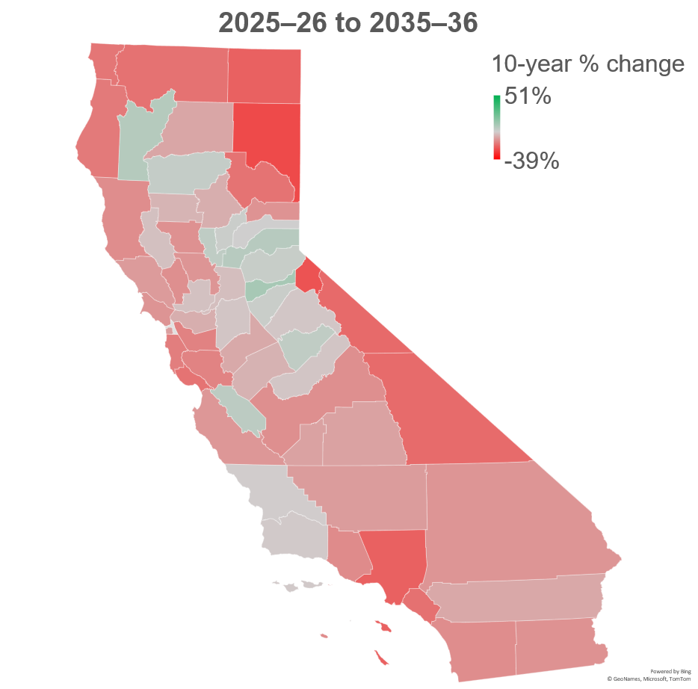
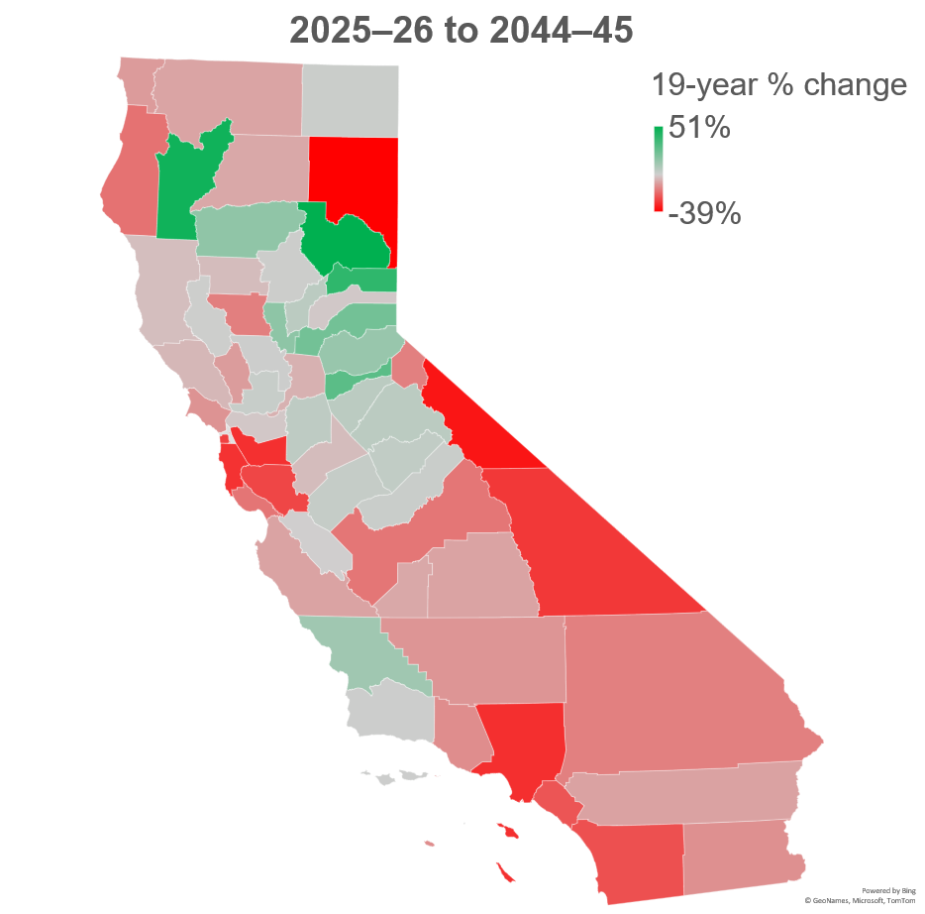
Public K–12 enrollment is forecasted to decline by 16% by 2044–45
Due to declining birth rates and migration patterns, public K–12 enrollment is likely to decline for the foreseeable future
However, forecasted enrollment varies significantly by county
Notes:
Patrick
INCREASES: Placer County, California 23% Amador County, California 29% Sierra County, California 39% Trinity County, California 47% Plumas County, California 51%
DECLINES: Lassen County, California -39% Mono County, California -35% Los Angeles County, California -30% Alameda County, California -30% San Mateo County, California -29%

Slide 7
LEAs are projecting declining ADA, modest revenue increases, and uncertainty in federal revenue
LCFF revenue growth is driving overall revenue stability
LEAs project that federal revenues will change by 0% 2025–26 and 2027–28
  Federal revenue had the widest range of projections of these data (-64% to +13%)
Note. Data from multi-year projections described on approved budget documents for FY 2025–26. Budget documents obtained through June board meeting minutes.
Notes:
Patrick
Voiceover on 0% federal changes – not necessarily the case that LEAs are confident that federal revenue will be small. 0% was median change in federal revenue between 25/26 and 27/28. 68 districts expected 0% change, 20 expected an increase in federal revenue (usually small), 37 expected a decrease in federal revenue.
Also, standard errors were largest for federal revenue – widest range of projections means a LOT of uncertainty.

Slide 8
LEAs are projecting deficit spending, but trends vary by district type
All district types are projecting minimal increases in expenditures, if at all
Elementary and high school districts expect to draw down a significant portion of their reserves by FY 2027–28
Note. Data from multi-year projections described on approved budget documents for FY 2025–26. Budget documents obtained through June board meeting minutes.
Notes:
Patrick

Slide 9
District fiscal health follows broader economic trends
California school districts were in poor fiscal health during, and for several years after, the Great Recession
The number of districts with a “Negative” or ”Qualified” certification is increasing, but low compared to previous years
All pandemic relief funds have now been spent
Note. Data from California Department of Education, July 2024. A “Negative” certification indicates an LEA will not meet its financial obligations in the current or subsequent fiscal year; a “Qualified” certification indicates an LEA may not meet its financial obligations in the current or two subsequent fiscal years.
Notes:
Patrick
District fiscal health follows that of broader economy
In the grand scheme, most districts are doing okay – but this could change now that one-time funds are gone
Between 22/23 and 23/24, last two bars on this chart, the number of negative certified districts has doubled from 3 to 6, and the number of qualified has more than doubled from 10 to 23
Negative: Calaveras, Humboldt, SFUSD, Siskiyou, Siskiyou
Qualified: 2 Alameda, 2 Amador, 1 Contra Costa, 1 Lake, 2 LA, 1 Mendocino, 2 Riverside, 1 Sacramento, 1 San Diego, 1 Santa Barbara, 2 Santa Clara, 2 Shasta, 1 Siskiyou, 1 Solano, 3 Sonoma
Poor fiscal health lasts longer than recession
CA also especially dependent on capital gains tax revenue – this is why Great Recession hit so hard and why we have been generally okay in recent years.

Slide 10
Elevated student need, stagnant revenue, and significant fiscal uncertainty
Student needs remain elevated while enrollment declines, and revenue decreases
LEAs are moderately healthy compared to previous years but are projecting revenues and expenditures to be flat through 2027–28
Federal funding cuts and broader economic uncertainty have significantly complicated budgeting decisions
Notes:
Patrick
Discuss uncertainty

Slide 11
Poll

Slide 12
The board member perspective:
Trustee Valerie Florentino Davis
Notes:
Intro: The role of the board
a lot of offerings on ed finance are guided towards district admin
board members have a critical role as budget stewards
How can you make the most of your role?

Slide 13
Prioritizing Investments
Notes:
Kelsey
As Trustee Davis just described, the role of board members as fiscal stewards is critically important given the uncertainty around current and future funding.
Now we are going to talk about strategies for prioritizing investments
The strategies we plan to explore have the potential to support data informed decision making about the budget that puts student needs and student outcomes at the center.

Slide 14

Why is it important to take a systematic approach to prioritizing investments?
MOST schools and districts offer a wide variety of programs and services beyond the core curriculum.
BUT it can be challenging to identify which programs and services are having the greatest positive impact for students.
Notes:
Kelsey
Why is it important to take a systematic approach to prioritizing investments?
Many programs are offered.
Many programs and services do not have a clearly articulated objective or metrics for determining whether those objectives were met.
so it’s difficult to know which programs are having the greatest impact
And therefore, difficult to make decisions about which programs to sustain, to sunset, or when a new program is needed

Slide 15
High-level considerations for budget decisions
Student needs
Program impact
Funding
Notes:
Kelsey
Now we want to focus on high level considerations for budget decisions
School system leaders have made great strides in using data to understand student needs to determine how to focus investments
ROI strategies in education extend the use of data to also focus on program impact by looking at the outcomes for students involved in a program and at the cost of the program.

Slide 16



A range of options for understanding impact
Rigorous evaluations:
High cost, large-scope, multi-year efforts
Example: partnering with a university or research group to pilot and evaluate new EdTech software
Academic ROI:
Efforts to quantify the cost and benefits of a program or investment
Example: analyzing the costs of a new reading intervention program alongside data on students’ literacy growth
Analysis of existing data:
Analysis of data already being collected for accountability purposes
Example: making note of academic achievement or growth by student group
Notes:
Rigorous: can get at causal cost/impact estimates, often involves collection, analysis of novel cost and outcomes data for every aspect of a program (not very feasible when resources are limited)
AROI: important thing here is analyzing costs beyond the initial purchase, e.g. when teachers need to be trained up on a new program, you must account for the cost of their time spent in training. Relatedly, this may also translate to better ROI in 2nd, 3rd, etc. years of implementation. Also note that these data may already be collected for LCAP purposes
Existing data: not necessarily systematic, hard to quantify impacts but easy to access data.

Slide 17



Pairing information about program effectiveness with program cost can help districts understand the following:
Resource Use | Which resources are used for each program? Which programs require the largest resource use?
Decision-Making to Maximize Impact | If we must make trade-offs between programs, which ones are providing the greatest benefit for dollars spent? Are we getting more learning gains for our money in some programs compared to others?
Future Investigation and Process | What additional data is needed to capture the measures of investment and impact that we care about? What resources remain uncertain or cannot be quantified?
Notes:
So, what might you learn by pairing program effectiveness data with program costs.
First, it can help you understand in more depth, resource use in the district. Which resources are used for each program beyond just the funding. For example, how much time is involved for teachers or others, and which programs require the most resources?
Second, pairing program effectiveness data/or student outcome data with program costs can allow the district to more systematically make decisions about any shifts in programs because it provides information on whether student achievement is improving more rapidly for your money in one program vs. another.
Finally, it can be used to help identify any gaps in current data collection. Most districts do not currently have the infrastructure to look at costs and student outcomes together.
You may discover that some currently funded programs do not have clearly identified objectives and metrics for understanding whether or not those objectives are being met. Defining clear objectives and metrics is a starting point for making decisions about investments in the future.

Slide 18
Prioritizing programs with impact
Determine which programs to focus on
Prioritize programs based on impact
Determine which programs to stop, start, keep
Notes:
At a very high-level, prioritizing programs with impact includes three critical components.
Which programs are high priority to focus on in this investigation? Is the district really focused on early literacy gains in your LCAP. Do you start by looking at these programs? Or maybe you start with the largest programs in the district. This step generally involves creating some sort of inventory of programs and then asking for each program – do they have clearly defined objectives and metrics for measuring progress?
Once you have determined which programs to focus on, and which metrics are important for demonstrating progress for those programs, begin to review your data on both cost and student outcomes. Based on this analysis, which programs are providing the greatest returns?
Determine which programs to stop, start, or keep based on these data, data on student needs, and your available budget and funding sources

Slide 19
Student-outcomes focused governance in action:
Fresno Unified School District

Slide 20
Group discussion

Slide 21
For additional information
Mary Gardner Briggs
Senior Director, Research and Education Policy Development
California School Boards Association
mbriggs@csba.org
Dr. Kelsey Krausen
Director, Education Finance & Systems Planning
WestEd
kkrausen@wested.org
Patrick McClellan
Research Associate, Education Finance & Systems Planning
WestEd
pmcclel@wested.org

