Slide 1
The CSBA County Board Handbook: Fiscal Leadership and Governance

Slide 2

Housekeeping
Please use the Q&A feature to submit your questions. This is located on the ribbon below the speaker. The chat feature has been turned off.
Your questions will be answered either in the Q&A feature in writing or live by our presenters
All attendees will receive a link to this video recording as well as resources in a follow up email after the webinar.

Slide 3
Panelists:
Travis Haskill, Assistant Superintendent, Fiscal Services, Butte COE
Aaron Heinz, Deputy Superintendent, Colusa COE; Immediate Past-President, California Association of School Business Officials
Moderator:
Mike Walsh, CSBA Director, County Board Services

Slide 4
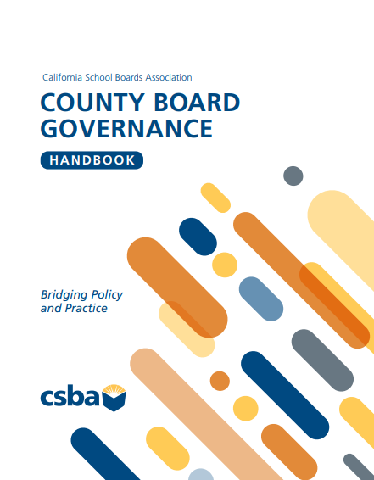

Slide 5


A Quick Note:
Technical & Adaptive
Compliance - Programs, practices, services, policies, plans, interventions, etc.
Transformation - Values, attitudes, biases, beliefs, experiences, relationships

Slide 6
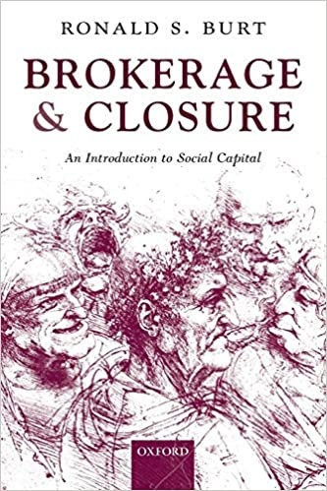
Closure – the quality of member relations within the board.
Brokerage – board member influence on outside stakeholders and those with influence.
School Board Capital
Notes:
Page 11 in the Handbook

Slide 7
Limited closure warnings
Limited closure leads to individuals acting for their own interests rather than the good of the entire organization.
Ongoing power struggles
Missed opportunities
Loss of influence in the community
Focus on a specific interest group only
The cure
Team building that focuses on developing trust, collaboration, and articulating a shared vision

Slide 8
Q&A

Slide 9
Upcoming Events:
County MIG
Aug 14-15,Yolo COE
Sep 24 - Marina Del Rey Marriott
Counties Conference
Sep 25-27, 2026
Marina Del Rey Marriott Registration opens May 13th
Call for Proposals Friday, June 12, 2026
  Advocacy, Governance & Policy
  Funding, Workforce & Educational Access
  Student Well-Being, Safety & Success
AEC
Workshop
Conference

