Slide 1
The CSBA County Board Handbook: Perspectives on Shared Governance

Slide 2

Housekeeping
Please use the Q&A feature to submit your questions. This is located on the ribbon below the speaker. The chat feature has been turned off.
Your questions will be answered either in the Q&A feature in writing or live by our presenters
All attendees will receive a link to this video recording as well as resources in a follow up email after the webinar.

Slide 3
Panelists:
Nicole Glentzer, Mendocino County Superintendent of Schools
Dr. Faris Sabbah, Santa Cruz County Superintendent of Schools
Derick Lennox, Senior Director, Governmental Relations & Legal Affairs, California County Superintendents
Moderator:
Mike Walsh, CSBA Director, County Board Services

Slide 4
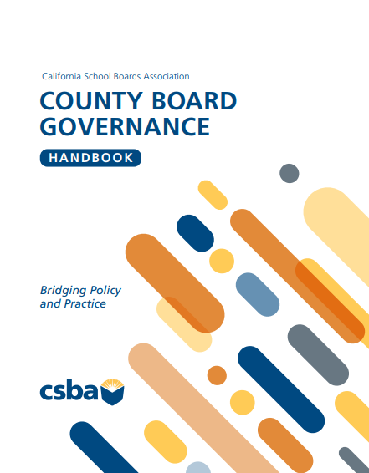
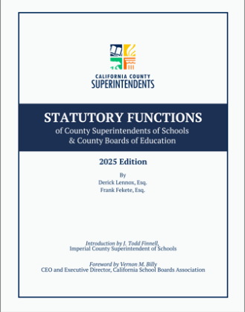

Slide 5


A Quick Note:
Technical & Adaptive
Compliance - Programs, practices, services, policies, plans, interventions, etc.
Transformation - Values, attitudes, biases, beliefs, experiences, relationships

Slide 6

Closure – the quality of member relations within the board.
Brokerage – board member influence on outside stakeholders and those with influence.
School Board Capital
Notes:
Page 11 in the Handbook

Slide 7
Limited closure warnings
Limited closure leads to individuals acting for their own interests rather than the good of the entire organization.
Ongoing power struggles
Missed opportunities
Loss of influence in the community
Focus on a specific interest group only
The cure
Team building that focuses on developing trust, collaboration, and articulating a shared vision

Slide 8
BOARD BYLAW 9240- What is it?
CSBA Board Bylaw 9240 Board Training states:
(For District and County Offices)
“The Governing Board believes that the Board’s ability to effectively and responsibly govern the district/county is essential to promoting student achievement, building positive community relations, and protecting the public interest in district/county schools. Board members shall participate in mandatory ethics training as outlined below and are encouraged to participate in ongoing opportunities for professional development sufficient to help them understand their responsibilities, stay abreast of new developments in education, and improve governance skills.”

Slide 9
Q&A

Slide 10
Upcoming Events:
AEC
Workshop
Conference
County MIG
Aug 14-15,Yolo COE
Sep 24 - Marina Del Rey Marriott
Counties Conference
Sep 25th-27th, 2026
Marina Del Rey Marriott

