Slide 1
The CSBA County Board Handbook: Lessons and Inspiration from County Board Members

Slide 2

Housekeeping
Please use the Q&A feature to submit your questions. This is located on the ribbon below the speaker. The chat feature has been turned off.
Your questions will be answered either in the Q&A feature in writing or live by our presenters
All attendees will receive a link to this video recording as well as resources in a follow up email after the webinar.

Slide 3
Panelists:
Jessica Speiser, Delegate, Region 20, Santa Clara
Alastair Roughton, Trustee, Butte
Gwen Dowdy Rodgers, Delegate, Region 16, San Bernadino
Ramon Flores, Director-at-Large, County, Ventura
Moderator:
Mike Walsh, CSBA Director, County Board Services

Slide 4
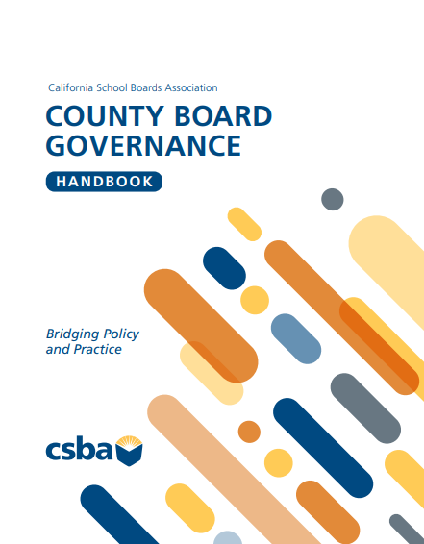
  County offices of education primer
    What metrics or indicators do you regularly review that help you understand whether your COE is meeting its mission?
    As a trustee, how do you see your role in advancing the county office's mission to serve every student – no matter their zip code, background or circumstance?
    Describe a time when your board had to lead during a moment of public uncertainty. What role did your COE play in navigating the challenge?
    Many students serve by COEs face challenges related to homelessness, disability, poverty or justice system involvement. What can your board do during the budget adoption process to ensure programs serving those students are resourced, supported and regularly evaluated for impact?
Notes:
Alastair

Slide 5
  County offices of education primer
  County office students, programs and services
    County board members influence the academic and behavioral priorities for COE students through adoption of the LCAP, curriculum approvals and budgetary decisions.
    What guides your board's decision-making when reviewing instructional programs, graduation pathways or credit recovery options?
    From juvenile court schools to CTE, the instructional landscape of a COE is broad and deeply responsive to student need. Which program or student population is your board least familiar with? What steps can the board take to better understand their needs?
    Students often depend on services provided through partnerships with probation, social workers, counselors and mental health providers. What partnerships are most critical to student success in your COE and how can your board work with the superintendent strengthen or support them?
    Effective oversight of charter schools, ROC/Ps and other instruction0al program requires both data and context. What indicators do you rely on when evaluating whether a program is meeting student needs?
Notes:
Alastair

Slide 6

Closure – the quality of member relations within the board.
Brokerage – board member influence on outside stakeholders and those with influence.
School Board Capital
Notes:
Page 11 in the Handbook

Slide 7
Q&A

Slide 8
County Board Governance Handbook

Slide 9
Upcoming Events:
AEC
Workshop
Conference
County MIG – March 10, 2026
County Workshop – March 11-12, 2026
Coast2Coast Federal Advocacy– April 13 – 15, 2026

