Slide 1
The CSBA County Board Handbook: A Tool for Great Governance

Slide 2

Housekeeping
Please use the Q&A feature to submit your questions. This is located on the ribbon below the speaker. The chat feature has been turned off.
Your questions will be answered either in the Q&A feature in writing or live by our presenters
All attendees will receive a link to this video recording as well as resources in a follow up email after the webinar.

Slide 3
Panelists:
Dr. Charles Weis, CSBA Governance Consultant
Christopher Maricle, CSBA Director of Training
Moderator:
Mike Walsh, CSBA Director, County Board Services

Slide 4
BOARD BYLAW 9240- What is it?
CSBA Board Bylaw 9240 Board Training states:
(For District and County Offices)
“The Governing Board believes that the Board’s ability to effectively and responsibly govern the district/county is essential to promoting student achievement, building positive community relations, and protecting the public interest in district/county schools. Board members shall participate in mandatory ethics training as outlined below and are encouraged to participate in ongoing opportunities for professional development sufficient to help them understand their responsibilities, stay abreast of new developments in education, and improve governance skills.”
Key Takeaway – Knowledge building leads to :
Better informed board members, which
Leads to better strategic decision-making and effective governance

Slide 5
This is a divider slide. Insert headline here.

Slide 6
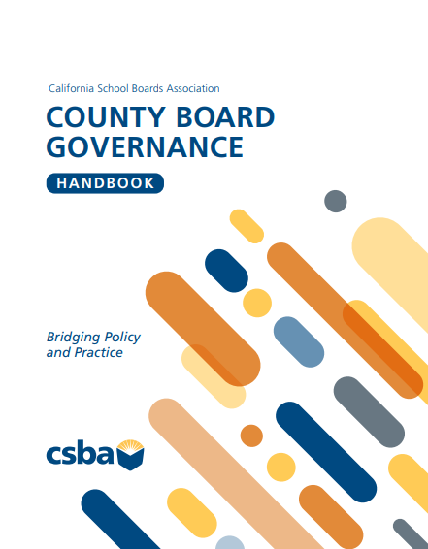
County Board Governance Handbook
Why?
What sets it apart from other handbooks?
  County offices of education primer
  County office students, programs and services
  Funding the county office
  County board of education members: a unique role in California’s public education system
  County superintendent of schools: An office with significant administrative and oversite responsibilities

Slide 7
About the Handbook:
County offices of education primer
County office students, programs and services
Funding the county office
County board of education members: a unique role in California’s public education system
County superintendent of schools: An office with significant administrative and oversite responsibilities

Slide 8
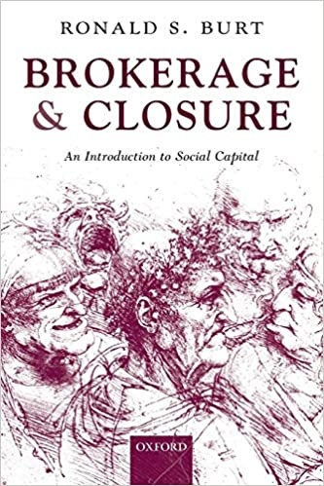
Closure – the quality of member relations within the board.
Brokerage – board member influence on outside stakeholders and those with influence.
School Board Capital
Notes:
Page 11 in the Handbook

Slide 9
Q&A

Slide 10
County Board Governance Handbook

Slide 11
Placeholder for MIG COE.

Slide 12
BOARD BYLAW 9240- What is it?
CSBA Board Bylaw 9240 Board Training states:
(For District and County Offices)
“The Governing Board believes that the Board’s ability to effectively and responsibly govern the district/county is essential to promoting student achievement, building positive community relations, and protecting the public interest in district/county schools. Board members shall participate in mandatory ethics training as outlined below and are encouraged to participate in ongoing opportunities for professional development sufficient to help them understand their responsibilities, stay abreast of new developments in education, and improve governance skills.”

Slide 13
One-line headlines are best, but never go over two lines
This is an example of a content slide
List only essential points — distill text down to major takeaways
Avoid full sentences
  Aim for less than 10 words per line
  Aim for less than 7 lines per slide
Remember: This is a listening exercise for the audience

Slide 14
Upcoming Events:
AEC
Workshop
Conference
AEC County Board Breakfast Dec. 4, 7:30 A.M.
Handbook Webinar #2 – February 18, 2026
County MIG – March 10, 2026
County Workshop – March 11-12, 2026
Coast2Coast Federal Advocacy– April 13 – 15, 2026

