Slide 1
CSBA Business Affiliate Webinar: Adapting with Purpose and Communicating with Confidence: Financial Strategy for California's Changing Education Landscape

Slide 2

Housekeeping
Please use the Q&A feature to submit your questions. This is located on the ribbon below the speaker. The chat feature has been turned off.
Your questions will be answered either in the Q&A feature in writing or live by our presenters
All attendees will receive a link to this video recording as well as resources in a follow up email after the webinar.

Slide 3

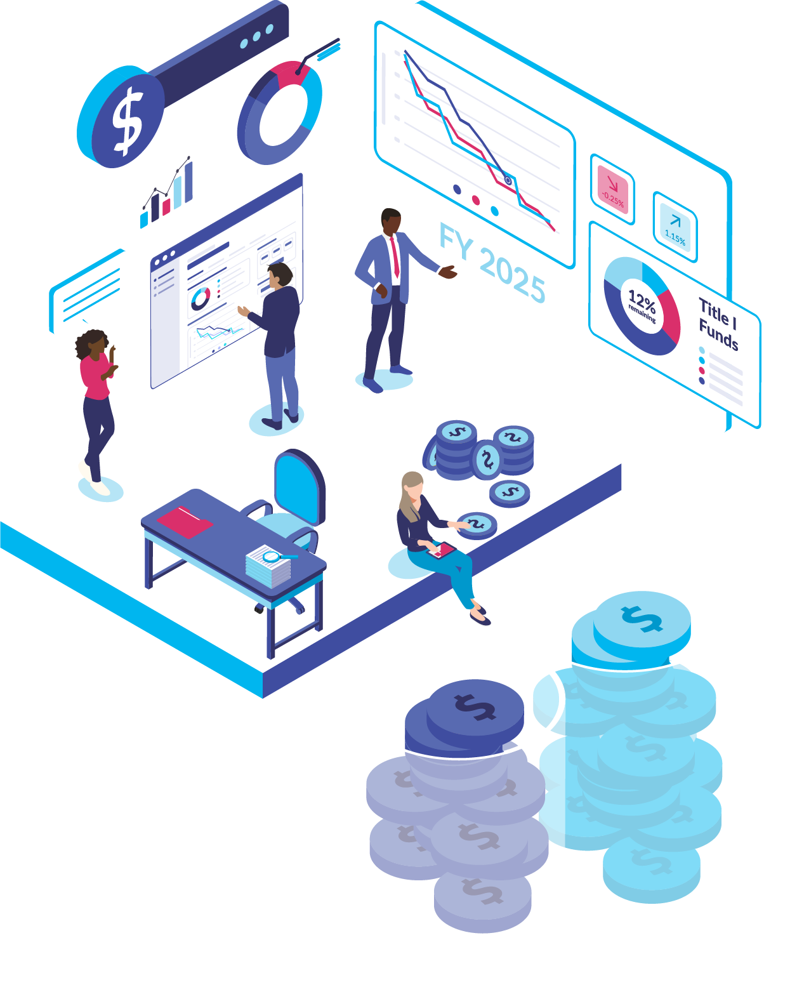

Every Dollar
for Every Student
Adapting with Purpose & Communicating with Confidence:
Financial Strategy for California's Changing Education Landscape

Slide 4

Agenda
Financial Landscape
What is a Budget?
What is a Resource Allocation Plan?
The Optics of Budget
Notes:
This slide should be adjusted based on if they are on one of our ERPs or if they have other PowerSchool products. Specifically bullet two.

Slide 5
Financial Landscape

Slide 6
Budget pressures
Enrollment shifts
Increased competition
State funding policies
Federal funding
uncertainty
Staff shortages
Aging facilities/infrastructure
Increasing student needs
California Funding Formulas
Costs increase faster than funding
Pension systems
Higher rates of SpEd
Widespread poverty
Mental health crisis
Rise of homeschool/micro-school
Charters
Remote work 👉🏻 labor competition
Reduced enrollment in teacher prep
Retirement & attrition
Private Schools

Slide 7
At a National Level:
NCES reports that:
K-12 enrollment is projected to decline by nearly 8% by 2031

Slide 8
At a State Level:
CA DOF reports that:
K-12 enrollment is projected to decline by nearly 10% by 2034

Slide 9
At a County Level:
2022
As enrollment has continued to decline.
As enrollment has continued to decline. Those students that remain, typically have higher needs.
2023
2024
2025

Slide 10



At a District Level:
Competing for Kids
Choice, charters, and mobility; enrollment isn’t guaranteed
District | Building
District trends don’t always tell the full story
Program Placement
Where are students located, not just where there is space

Slide 11
What is a Budget?

Slide 12
A Budget is a Plan:
It estimates the proposed expenses for a school year and the proposed means for paying for those expenses.
Expenses
What do we want to buy?
=
Revenues
How are we going to pay?
Salaries & benefits
Facilities & maintenance
Transportation
Technology
Instructional resources
Property taxes
Sales taxes
State aide
State & local grants
Federal grants

Slide 13
A Budget is a Moral Document:
It translates a district’s goals and priorities into tangible financial decisions that affect students, staff, and the community.
Goals
Budget
Priorities
Strategies

Slide 14
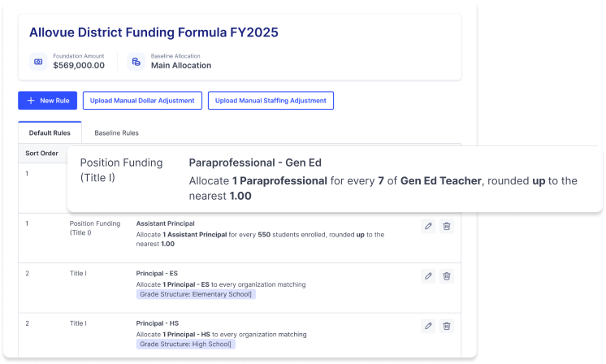
District Strategy must be backed by a Resource Allocation plan

Slide 15




A resources is something that can be used…
Time
The Allocation of Resources is the process of distributing available goods/services in a way that aligns with a district’s goals and priorities.
Staff
Technology
Money
Food ☺
Decrease average class size from 28 to 21 in grades k-3.
Allocate 20% increase over current year budget for PD.

Slide 16

Resource Allocation Plans
Provide an Objective Framework to:
Make Decisions:
Invest
Maintain
Sunset
Manage Consequences:
Communicate
Implement
Abandon

Slide 17
Do you have a Resource Allocation Plan?

Slide 18
You might have a resource allocation plan...
Your teacher contracts have guaranteed class sizes or student to teacher ratios.
Your bond levy has guaranteed class sizes or a requirement to spend dollars to lower class sizes.
You carry-forward your budget with adjustments based on inflation and other cost adjustments.
Your programs in schools are associated with certain staff and additional resources.
Your central office departments manage contracts with per pupil, teacher, school, or other units for cost.
Your grants have to be directed toward certain students or schools.

Slide 19
The Optics of Budget

Slide 20
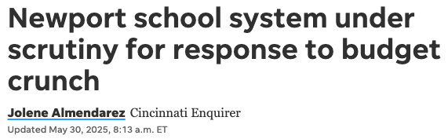


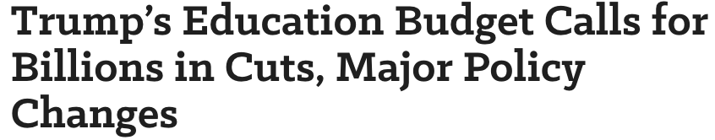
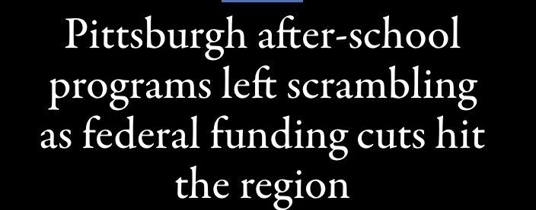
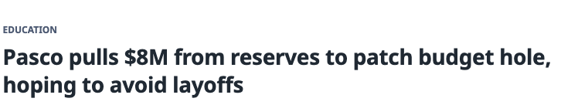
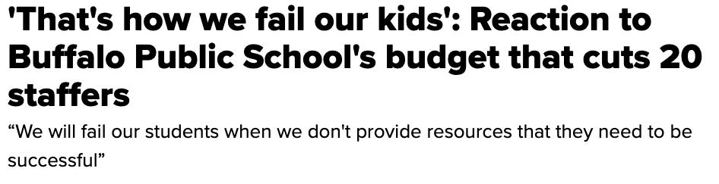
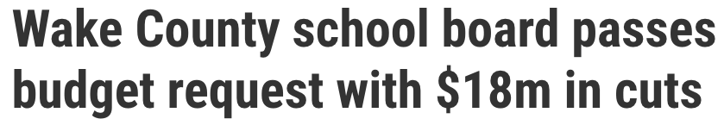
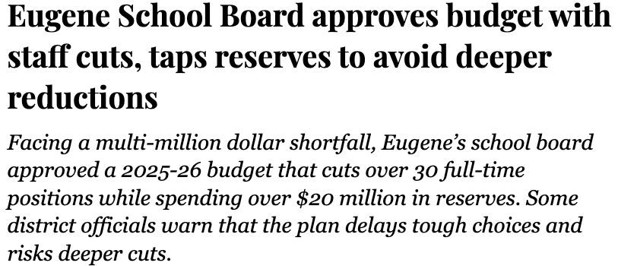

Budgets are in the News.

Slide 21
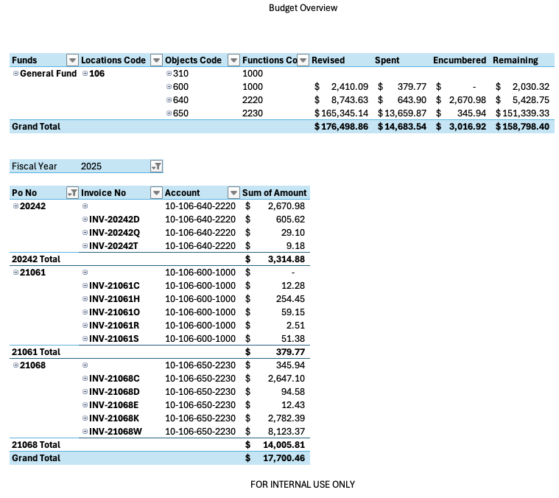
Transparency does not mean…

Slide 22
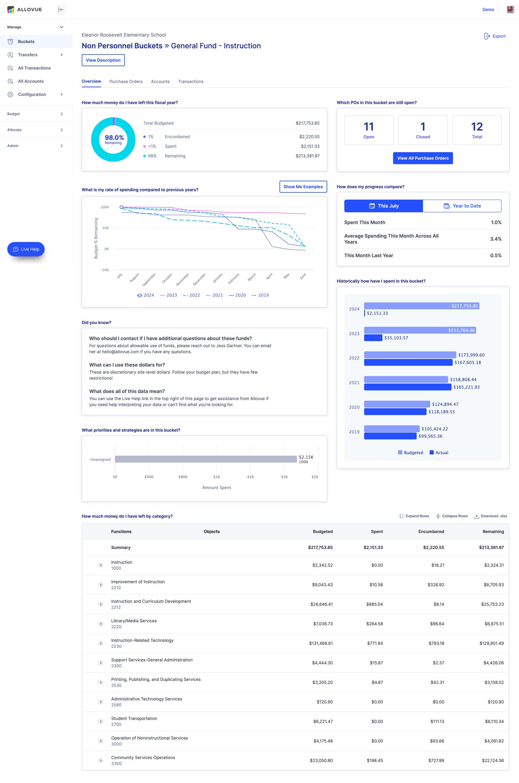
Transparency does not mean…
Clarity

Slide 23
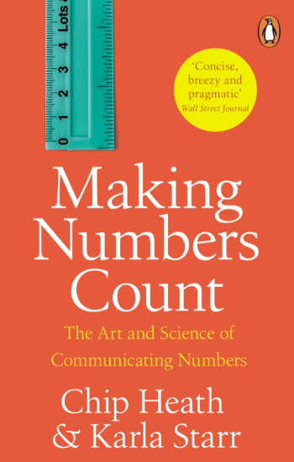
Question: is five a lot?

Slide 24
If People Don’t Understand Numbers, we might as well be speaking another language.
“We need over 1,000,000 square feet of roofing”
“We need to replace about 20 football fields worth of roofing.”
“We need over 1,000,000 square feet of roofing”

Slide 25
Make it Simple
Make Them Care
Show Them How
“It Costs $125,000”
“It Costs $125,000”
“This will impact every 4th & 5th grade student at one third of our elementary schools if approved.”

Slide 26
Connecting the Dots
There are numerous ways to slice and dice budget and spending data to tell a story, but the flip side is that any one number rarely tells the whole story.
When you think about education finance data– what other data points would help you see the whole picture?

Slide 27
Allovue: A Day in the Life

Slide 28
The Strategic Difference
District strategy must be backed by a resource allocation plan.
  Failure to do so leaves you dealing with the uncoordinated decisions made by departments, inefficiency, and waste.
Resource allocation strategies make it easier to:
  Adapt to financial constraints,
  Manage political pressures, and
  Influence Stakeholders.
Resource allocations give us the framework to:
  Make decisions, and
  Manage consequences.

Slide 29
The Strategic Difference
A budget is more than just accounts and amounts.
  Focusing on the rollover process, incremental adjustments, and budget book creation won’t improve student outcomes.
  Conventional budgeting practices make it difficult to adapt to change.
Clear and understandable data affects stakeholder influence.
  Transparency does not equal clarity.
  Time is better spent making decisions than on trying to understand accounts.
Budgeting is a year-round process.
  Budget owners make better decisions when they are engaged all year.

