Slide 1
2025
PRESENTER GUIDELINES

Slide 2

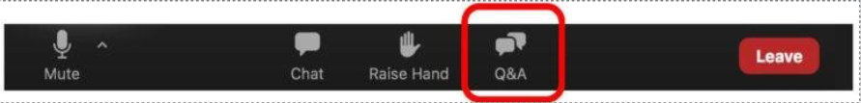
QUESTIONS
At the end of this training, we'll answer your questions via Zoom's Q&A feature—either live or in the Q&A panel.
We will share this training presentation with all of you.
Contact Information
If you have any additional questions, please contact: aec@csba.org.

Slide 3

AGENDA
Conference Logistics
Speaker Preparation
Session Flow
Technical Set-Up
Post-Conference
Q&A

Slide 4
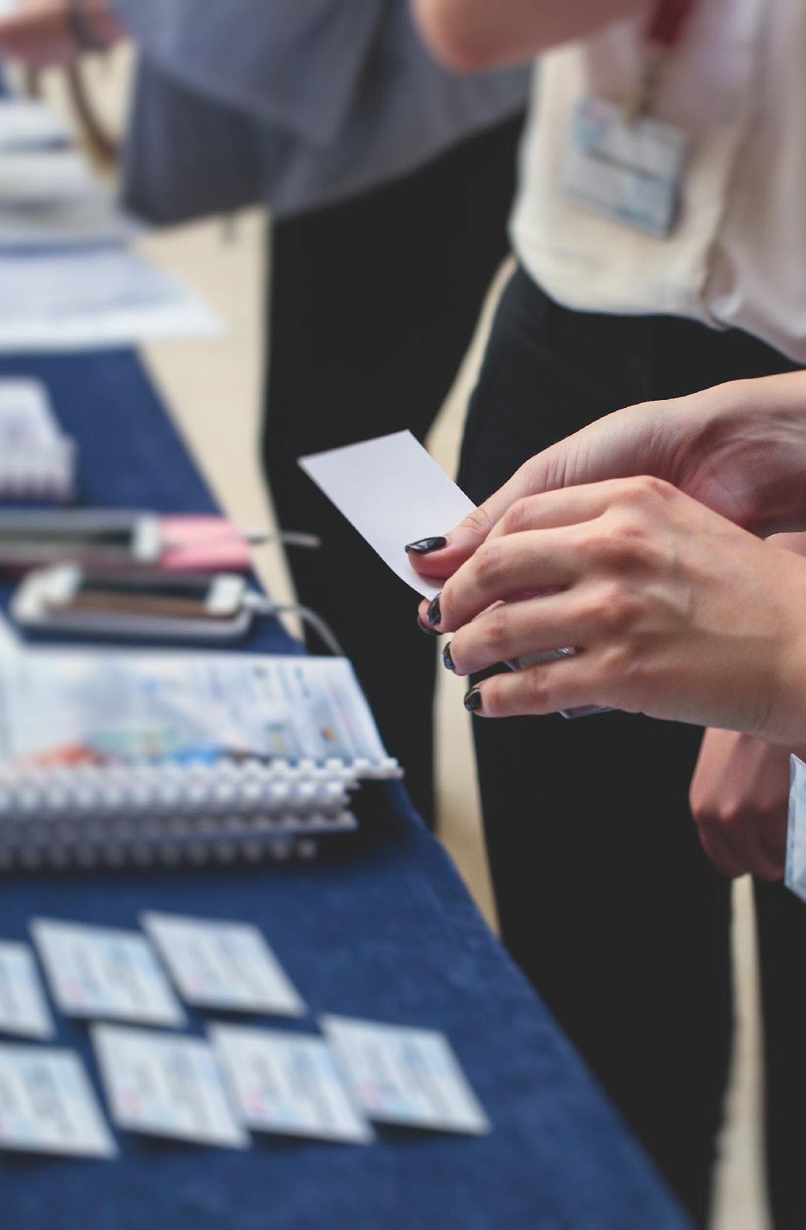
REGISTRATION AND HOUSING
Presenters will receive a complimentary one-day pass for the day of their presentation.
To attend the full conference, you must register at the standard rate.
To register for the full conference and/or reserve housing, please contact aec@csba.org.

Slide 5
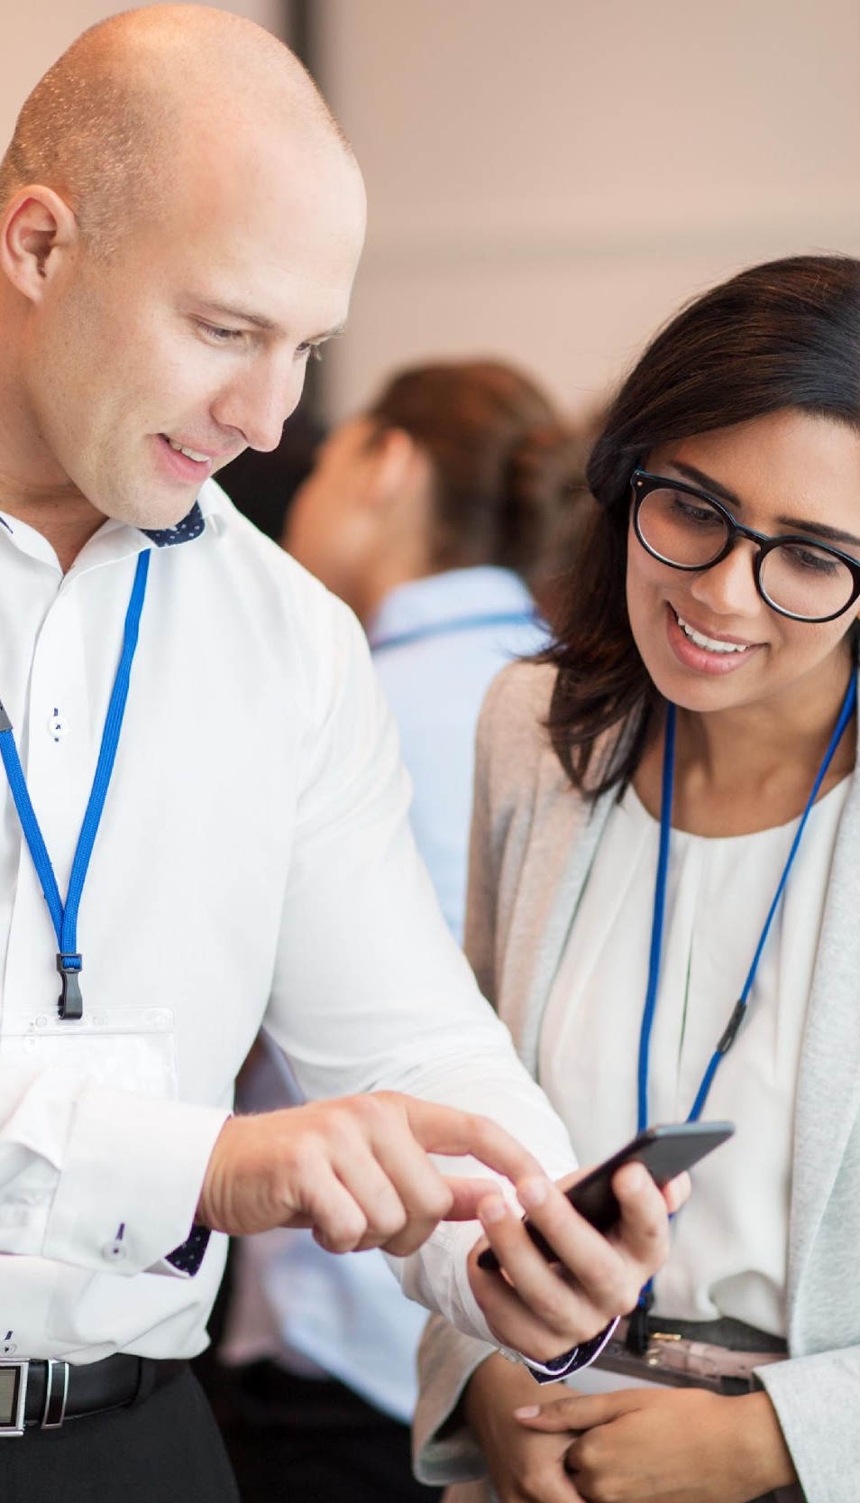
CONFERENCE APP
Conference app will be available in mid-November.
All registrants will receive an email with download instructions.
Ensure your email address is current during registration.

Slide 6

BADGE CREDENTIALS
Arrive at the SAFE Credit Union Convention Center one hour before your session.
Pick up your badge at the registration desk in the West Lobby.
Only registered presenters and attendees may access sessions.
Notes:
Do we need to update this to reflect different locations/hotels vs convention center?

Slide 7

PROGRAM SCHEDULE
This year’s sessions will cover the most critical and cutting-edge issues in public education.
View session descriptions now using the AEC Session Search.
  Find your session by keyword, date or presenter last name.
To view the full program, click here.

Slide 8

SUPPLEMENTAL MATERIAL
Optional: Submit supplemental materials as session handouts to be available via the AEC app.
Format: PDF only, max 10MB per file.
You may submit your PowerPoint as a PDF for use as a handout.

Slide 9

HEADSHOTS & BIO
Submit presenter headshots and bios (max 250 words) for the conference app.
Headshots: JPG, max 300x300 pixels, 5MB file size
Email materials with your session title to aec@csba.org by Thursday, October 23.

Slide 10
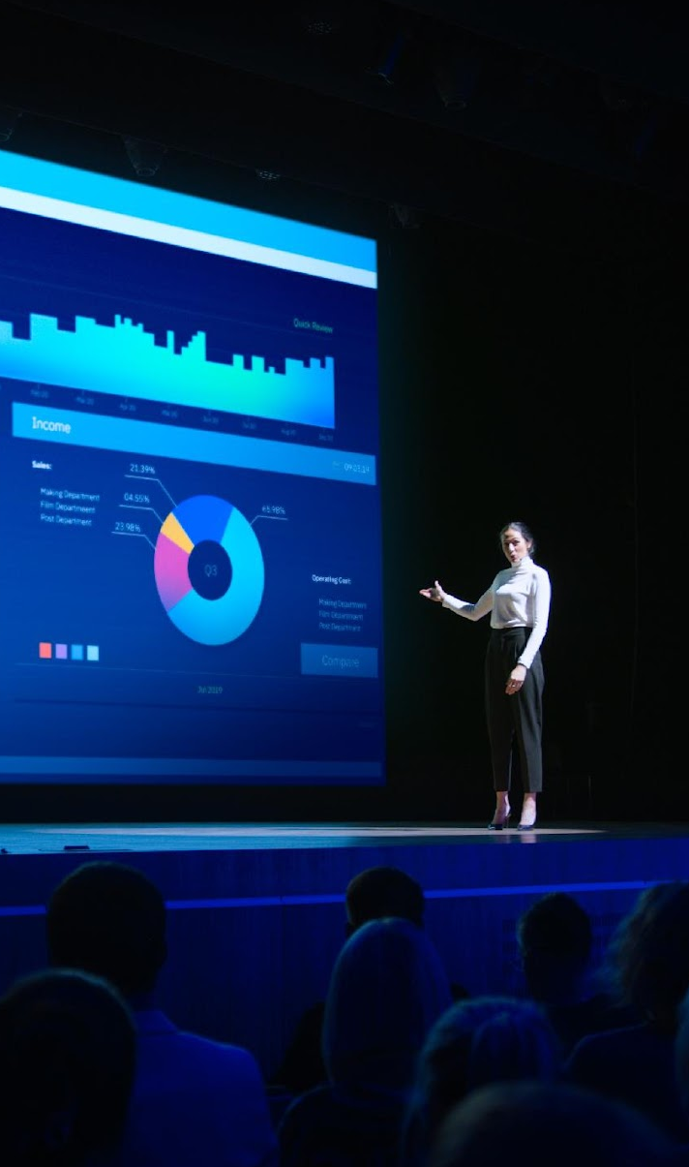
PREPARING YOUR
PRESENTATION
What is the program’s purpose?
Why was it proposed or what problem did it solve?
Was it successful?
What were the one-time and ongoing costs?
How was it funded, and were trade-offs required?
How did the governance team assess success?

Slide 11

TIPS AND TRICKS
Silence all electronic devices—and remind the audience to do the same.
Charge your laptop and bring all necessary power cords and adapters.
Engage your audience—use eye contact and positive body language.
Breathe, relax, and try to enjoy
your session!

Slide 12
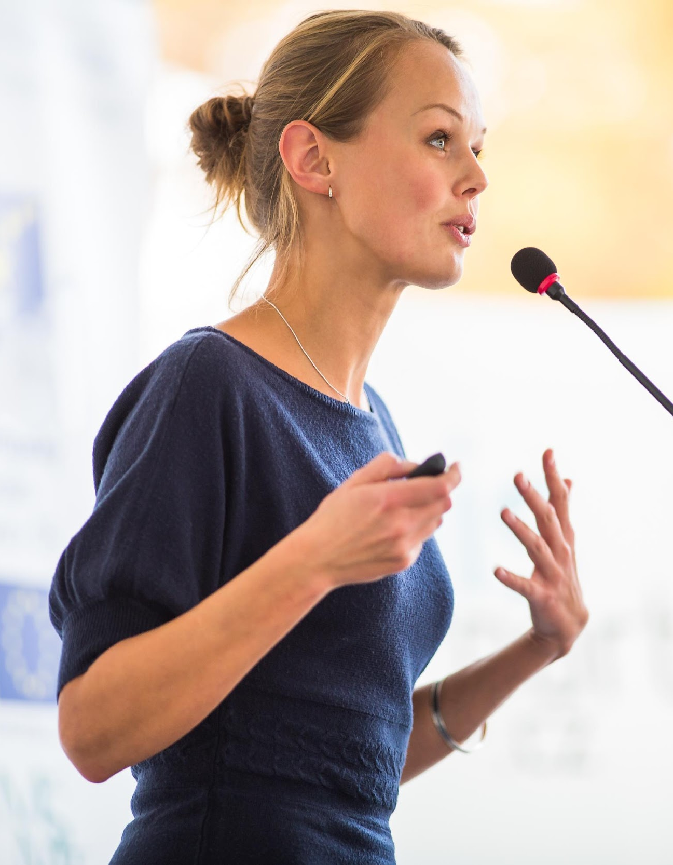
WHAT TO WEAR
Business casual apparel.
Avoid busy patterns, tightly spaced stripes.
CSBA or school-branded apparel is always acceptable.
Neat hairstyle.

Slide 13

PRE-SESSION
Arrive at least 20 minutes early.
Introduce yourself to other presenters, and help them meet each other.
Confirm titles and name pronunciations.
Meet the room monitor, whose role it is to:
  Contact staff for emergencies or tech issues.
  Track attendance.
  Monitor session time.

Slide 14
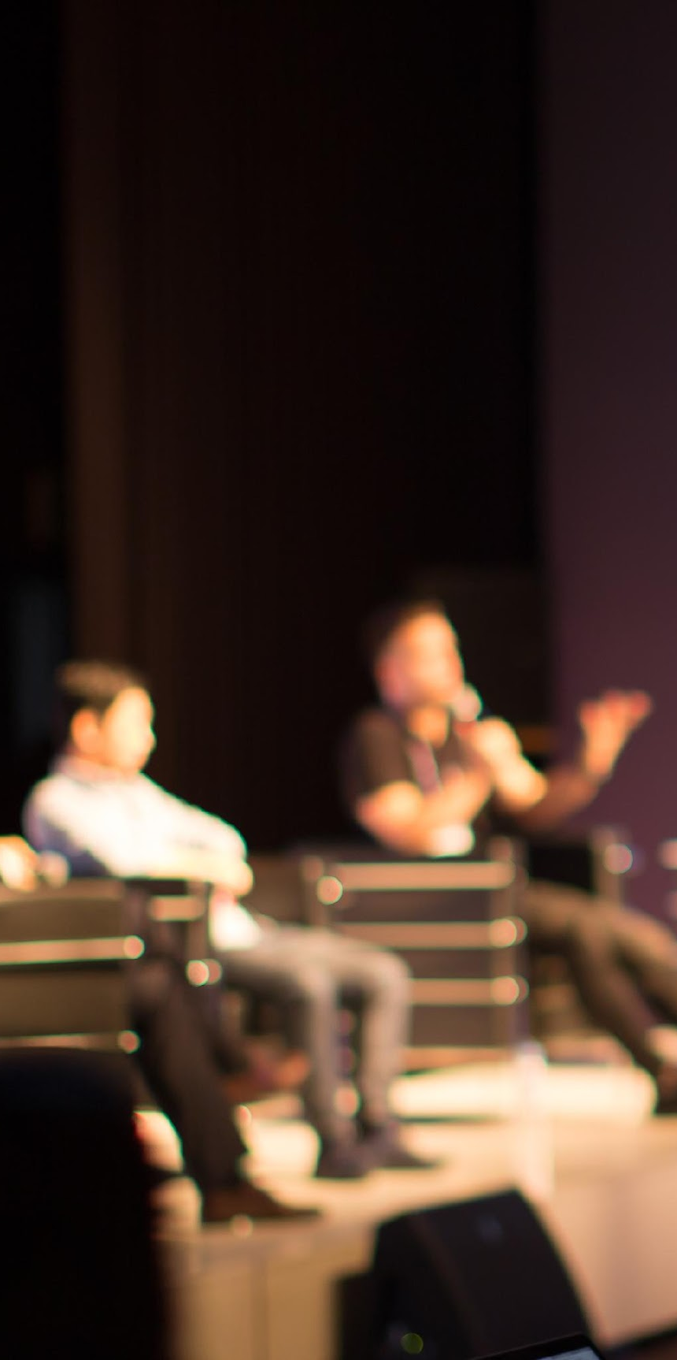
SESSION INTRODUCTIONS
Give a brief introduction of your speakers.
Introductions include name, title, and organization.
Be sure you can pronounce names correctly.

Slide 15

ENGAGING YOUR AUDIENCE
Educate, train or inform your audience.
Foster authenticity and meaningful connections.
Use simple, interactive techniques to create impact.
Please stay within your allotted time.

Slide 16

AUDIENCE QUESTIONS
End on time - Allow time for Q&A and keep the presentation on schedule.
Repeat audience questions into the microphone.
Stand at the podium mic to restate questions and comments.
  Or ask speakers to use the podium or table mic when responding.

Slide 17

CLOSING
Thank the speakers and lead a round of applause.
Clear the podium and stage promptly.
  The next presenters will need time to set up.

Slide 18

MICROPHONE NOTES
Please push your mic button when you’re speaking.
Hold the microphone 2 inches from your mouth for best sound quality.
Please be aware that loud jewelry and/or accessories hit your microphone causing noise and distortion.

Slide 19
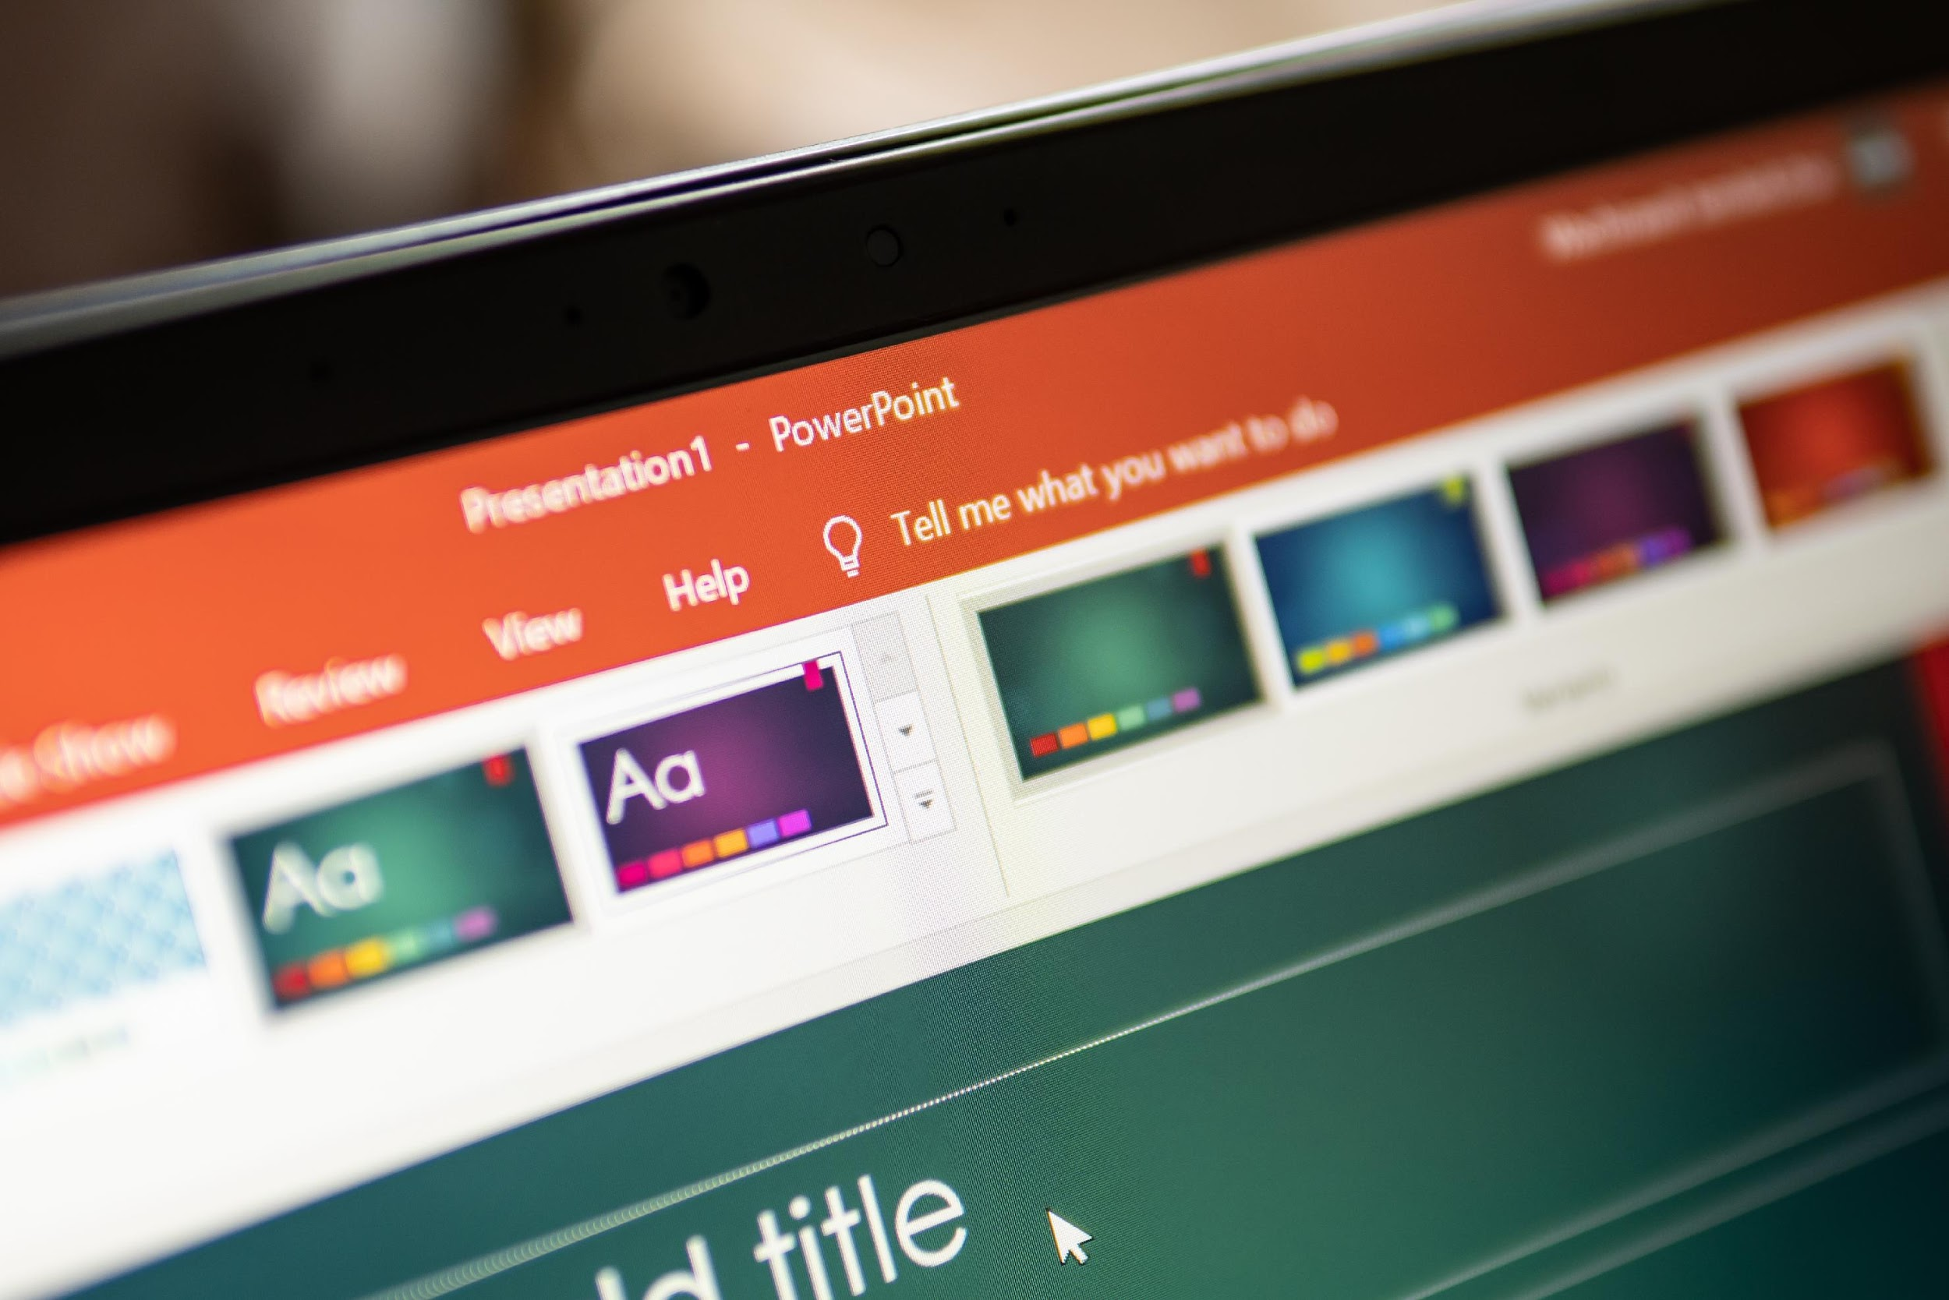
POWERPOINT
We encourage presenters to use the 2025 AEC PowerPoint template.
Use large, readable text.
Choose contrasting colors for visibility.
Stick to clear, easy-to-read fonts.
Don’t read from the screen.
Avoid long sentences.
Use images to communicate, not just decorate.

Slide 20
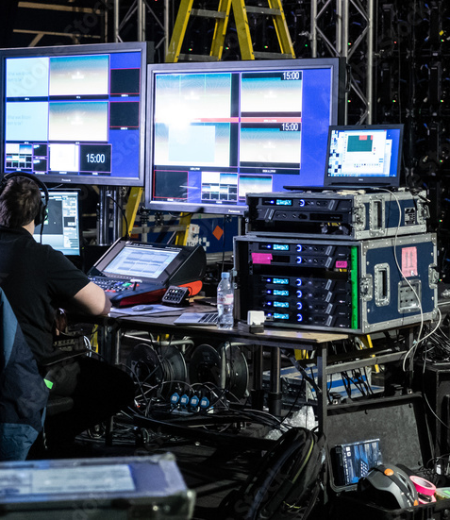
AUDIO-VISUAL
All session rooms will be prepared with the following set up and audio/visual equipment:
Head table for three people with a standing podium for a fourth presenter.
Podium microphone and table-top microphones.
Large screen and LCD projector.
Audio projection capabilities.
Wi-Fi.
Due to the high cost of audio/visual equipment, setup and maintenance, CSBA is unable to make any changes to what is provided above, and on-site requests will not be honored.

Slide 21

AUDIO-VISUAL (cont.)
CSBA will NOT provide the following and
presenters are responsible for providing these:
Laptops/computers and chargers.
Software for PowerPoint or other presentations already installed.
Presentation file.
HDMI adapter for your Mac or PC laptop/computer to connect with the provided LCD projector.
Due to the high cost of audio/visual equipment, setup and maintenance, CSBA is unable to make any changes to what is provided above, and on-site requests will not be honored.

Slide 22

POST CONFERENCE
Thank you for sharing your expertise at AEC through one of 100+ conference workshops.
Survey
Attendees are encouraged to complete a session survey on the AEC app after your session. To receive results, email aec@csba.org after the conference.

Slide 23
QUESTIONS
This training outlines key expectations and support, but CSBA may adjust as needed
for a successful conference.
Please direct your questions to aec@csba.org.

Slide 24
2025
PRESENTER GUIDELINES

