Slide 1
The ABCs of UTK – Planning for Universal Transitional Kindergarten in your District

Slide 2
Housekeeping
At the end of the presentation, we will have a Question-and-Answer segment where we will try our best to answer your questions
Please, use the Q & A feature of Zoom to type your questions. This is located on ribbon below the speaker.
Your questions will be answered either in the Q & A panel or live by our presenters
All attendees will receive a link to the video of this webinar as well as the slide deck

Slide 3
Today’s Presenters
Sarah Neville-Morgan, Deputy Superintendent of Public Instruction, California Department of Education
Dr. Bruce Fuller, Professor, Education & Public Policy at University of California, Berkeley
Abigail Slovick, Doctoral Student, University of California, Berkeley
Dr. Stephanie Ceminsky, Director, Early Education Program & GATE, San Diego Unified School District
Sandra Lee, Preschool Coordinator, Weaver Union School District
Chris Reefe, Legislative Director, CSBA
Moderator - Jeremy Anderson, Education Policy Analyst, CSBA

Slide 4
Today’s Agenda
An introduction to universal transitional kindergarten
Questions board members should ask and where TK stands in California
A discussion on implementation and lessons learned at the local level
CDE guidance and alignment efforts
CSBA’s UTK legislative and funding efforts
Resources

Slide 5
An Introduction to Universal Transitional Kindergarten in California
Sarah Neville-Morgan, Deputy Superintendent of Public Instruction, California Department of Education

Slide 6
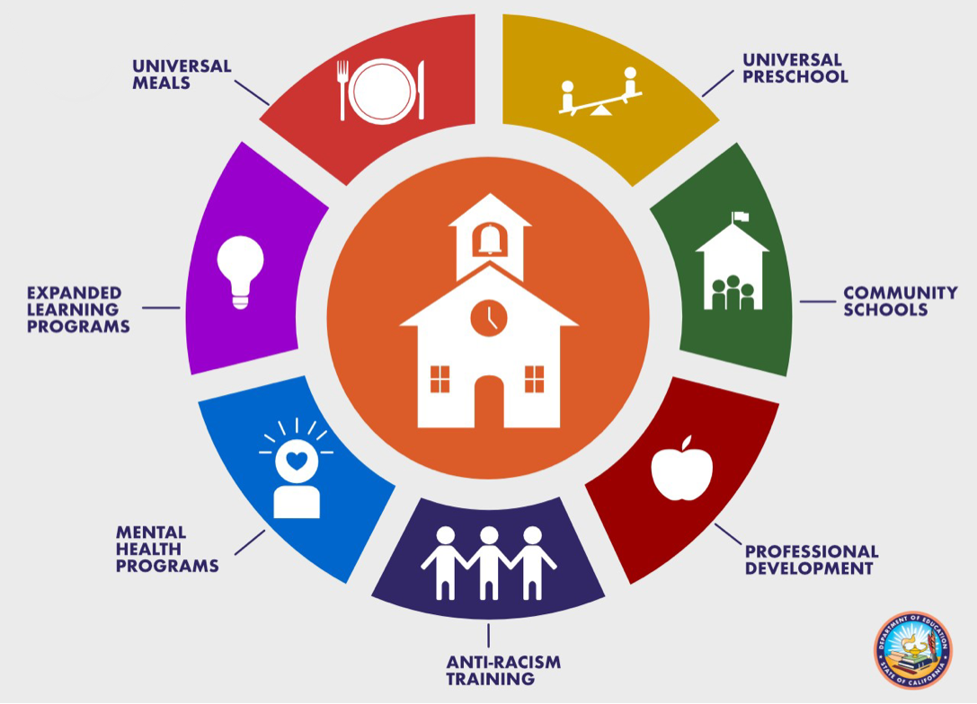
Transforming Schools

Slide 7
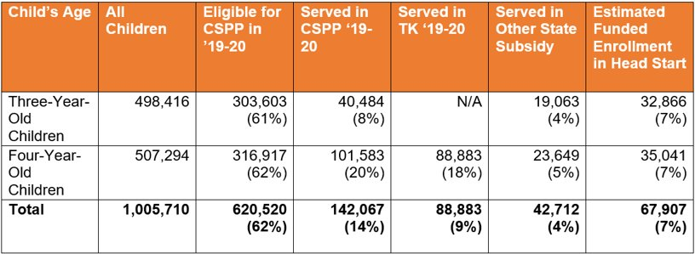
Who Are California’s Preschoolers?
California has 1 million three- and four-year-old children with access to a variety of programs
Notes:
SARAH:
Before diving into updates around UPK Guidance and P3 Curriculum, I just wanted to provide us all with a reminder of the broader context, and the importance of access to preschool.
CA has 3 million children under the age of 5 and provides them with inadequate access to early education.​
As we look at three- and four-year-old children specifically, ​
Only 38% of all 4-year-olds are enrolled in Transitional Kindergarten (TK) and/or the CA State Preschool Program (CSPP)​. Currently, 69% of our CSPP programs operate through an LEA, and the rest are with Community Based Organizations. (380 LEAs, 252 CBOs)
A whopping 81% of the entire 3-year-old population are NOT enrolled in any state subsidized early learning and care program
Because of the lack of access our preschoolers currently have to early education opportunities, This is CA’s Moment for Systematic Change. Our Vision is that CA will provide a strong and early start to education for all children with high-quality, joyful, developmentally informed, inclusive, and rigorous PreKindergarten (PreK) through 3rd grade (P-3) learning opportunities - beginning with equitable access to universal PreK (UPK).​
​
We know that CA can do better, but we also know that success in the face of this tremendous opportunity necessitates the combined efforts of partners, practitioners, and researchers from across a wide range of sectors, settings, and geographies to learn from and build upon the lived experience of our communities.
I will next provide some clarity on definitions, and introduce our UPK template and guidance documents.

Slide 8
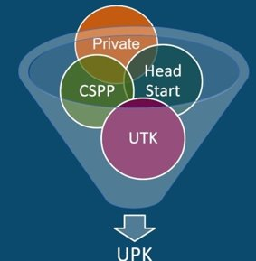
What is Universal Prekindergarten (UPK)?
UPK will bring together programs across early learning and K-12, relying heavily on Universal Transitional Kindergarten (UTK), and the California State Preschool Program (CSPP), as well as Head Start, community-based organizations (CBOs), and private preschool to ensure every 4-year-old child – regardless of language, race, zip code, immigration status, or income level– has access to a quality learning experience the year before Kindergarten
Notes:
So, what is UPK?​
UPK stands for Universal Prekindergarten, which, by 2025-26 will exist for all four-year old children in CA. A lot of people think that Universal Transitional Kindergarten (or UTK) and UPK is the same thing, so we wanted to clarify for you all how we are thinking about it at the CDE, and how LEAs are being asked to think of it as they work on their UPK Implementation Plans.​
UTK is part of UPK, but not the only part. UPK is a mixed delivery system that also includes the California State Preschool Program (CSPP) which the CDE operates, along with other prekindergarten programs serving 3- and 4-year old children, including the federal Head Start Program, subsidized programs that operate a preschool learning experience and are operated by community-based organizations--including family childcare--, and private preschool. Part of UPK is also the Expanded Learning Opportunities Program that helps TK-6th grade a full-day program aligned with the needs to parents.​
Statute is very clear that families with 4-year old children will have the choice in which prek program, contingent on eligibility, to send their four-year old child to if they would like to enroll their children in a PreK program. Just because a child is eligible for TK does not mean that the child has to be enrolled in TK... they could be enrolled in any of the other programs based on their preferences. ​
•However, given that TK will be funded to serve all four-year old children that show up by 2025-26, and the other programs are not, the more four-year old children served in TK can free resources to serve three-year old children in the other prek programs and provide more children with two years of prek before kindergarten. ​
Statute is also very clear that LEAs must plan for UPK, including thinking through these other ways UPK can be provided beyond TK, and how UPK can be made into a full-day. As a result, that is why CDE is using language around UPK, since just planning around TK does not address all the areas where LEAs are being asked to plan under state law.

Slide 9
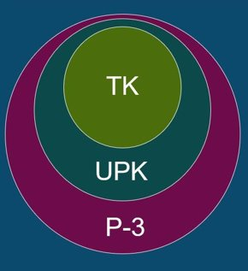
How do Transitional Kindergarten (TK), UPK, and P-3 Alignment Work Together?
Universal Transitional Kindergarten (UTK), is an integral program in the mixed delivery system for achieving UPK. It will be the only program that must serve any four-year-old child that wants to enroll by 2025–26.​
UPK is a mixed-delivery system of UTK, CSPP, Head Start, expanded learning, private providers, and more. It provides every four-year-old child access to high quality learning the year before Kindergarten.​
Prekindergarten to Third Grade alignment (P-3), Connects UPK with Kindergarten, First, Second, and Third grade. It aligns developmentally informed best practices, UPK–Third grade.
Notes:
So how do all these pieces work together? As we think about UPK implementation, we also want districts to think about it through a Preschool to Third grade lens, which is overarching work that CDE is leading to support LEAs as to connect the work they are doing across UPK, Kindergarten, 1st, 2nd, and 3rd grade, so there is a seamless continuum for students during their early years in the educational system. P-3 also focuses on aligning developmentally informed best practices UPK-3rd Grade. ​
This may look like aligning curriculum across these early stages and grades, joint professional development with preschool and kindergarten teachers, and supporting the transition between preschool and elementary school​
​

Slide 10
CA PreK – Third Grade Vision
California will provide a strong and early start to education for all children with high-quality, joyful, developmentally informed, inclusive, and rigorous prekindergarten (pre-K) through third grade (P-3) learning opportunities—beginning with equitable access to universal prekindergarten (UPK).
PreK education matters
Research evidence on the positive boost of high-quality PreK on child outcomes
Yet, disadvantaged and marginalized children tend to have the least access
Sustaining the PreK boost also matters
Supporting the transition to elementary school
Rigorous, standards-based instruction WITH child-initiated and playful learning
Align curriculum, assessments, and teachers’ professional learning
Notes:
So all of this UPK work lies within our broader Pre-K to third grade vision.
Our vision is that: California will provide a strong and early start to education for all children with high-quality, joyful, developmentally informed, inclusive, and rigorous prekindergarten (pre-K) through third grade (P-3) learning opportunities—beginning with equitable access to universal prekindergarten (UPK).
And this is all rooted in the fact that we know early education and PreK matter. There is undeniable evidence on the profound benefits of high-quality pre-K experiences on children’s brain development and key school readiness skills. Yet racially and historically marginalized, low-income, and multilingual children and children with disabilities have had the fewest opportunities to access effective and inclusive early education. This opportunity gap leads to the achievement gap that already exists when children enter kindergarten and too often persists throughout school.
And furthermore, we know that sustaining the pre-K boost through effective transitions and alignment across the early grades also matters. Effective pre-K helps prepare children for kindergarten, but is only one piece of the puzzle. The transition to, and quality of, the early elementary grades is also critical and must reflect developmental science so students maintain their passion for asking questions, searching for answers, and challenging their minds. Schools that embrace rigorous, standards-based instruction and child-initiated and playful learning, and that align curriculum, assessments, and teachers’ professional learning will nurture students’ skills and knowledge, strengthen their foundation for learning, and ensure they reach their full potential.

Slide 11
California’s Ambition – Expanding Transitional Kindergarten
Policy Brief and Questions for Local School Boards
Bruce Fuller and Abigail Slovick
University of California, Berkeley
April 2022

Slide 12
CSBA Brief – Questions for Board Members
Sketch contours of the state’s aspirations to expand transitional kindergarten (TK) out to all 4-year-olds over the next three years.
Put forward four key questions for local board members as they plan to expand TK programs.
Emphasize variation in local conditions and district needs and capacity.

Slide 13
Contours of New TK Policy
Widening TK access. Next year, 2022–23, districts must offer TK to children turning 5 years-of-age between September 2 and February 2.
A big lift. These birthdates move forward until all 4-year-olds gain TK access in 2025–26 (about 250,000 additional children).
Richer classroom staffing. An aide will be added to all TK classrooms, improving the child:staff ration to 12:1 (2022-23).
Surge in teacher demand. Another 11,000 TK teachers will be required, and upwards of 25,000 aides – amidst a teacher shortage.

Slide 14
Four key questions for board members to ask –
Question 1. How will our district map-out their required TK plan by June 30?
Question 2. Can we consolidate and streamline existing early-childhood programs?
Question 3. How will we find qualified teachers and classroom aides?
Question 4. Do we have sufficient classroom space to expand TK enrollments?

Slide 15
Question 1. How will our district create and coordinate TK planning practices?
Local boards must approve TK expansion plans by June 30.
Note that many TK programs run half-days… not sufficient for working parents.
Classrooms must be “developmentally appropriate,” which may require renovation or the construction of new classrooms to accommodate young children.
Planning might recognize the ‘ecology’ of other early care providers: nonprofit pre K’s, licensed child-care homes, and individual caregivers. Network with county offices?

Slide 16
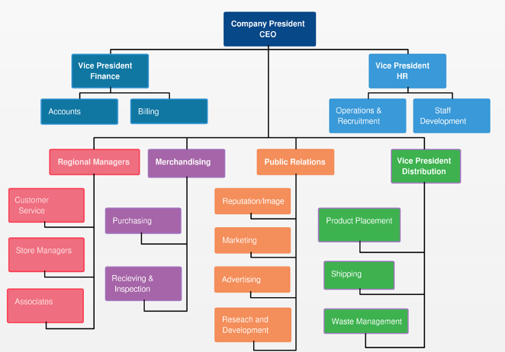
Question 2. Can we streamline the district’s existing early education programs?
Your district may already host State Preschool (CSPP), Head Start, or LCFF funded pre-K classrooms.
Who in the district office is looking after the CDE planning template and required elements for our planning?
Do we have an early-childhood manager at the district office, or can the county office of education lend a hand?
How will child-development goals and pedagogical practices mesh with, or depart from, our elementary education office?
Can we integrate the HR and labor relations pieces of TK into our core organization (beyond ’categorical’ thinking)?

Slide 17
Question 3. How do we find qualified teachers and classrooms aides?
Moving teachers from other grade levels? Some risks: their familiarity with “developmentally appropriate practices,” shift away from delivery of curriculum to arranging engaging activities for children?
State has pushed back requiring 24 units in early childhood education (to 2023-24), yet some districts mandate this preparation.
Grants are going out to districts, county offices, and universities for expanded credential programs.
CDE is revising Pre-K Learning Foundations, centered on cognitive skills and social-emotional development.

Slide 18
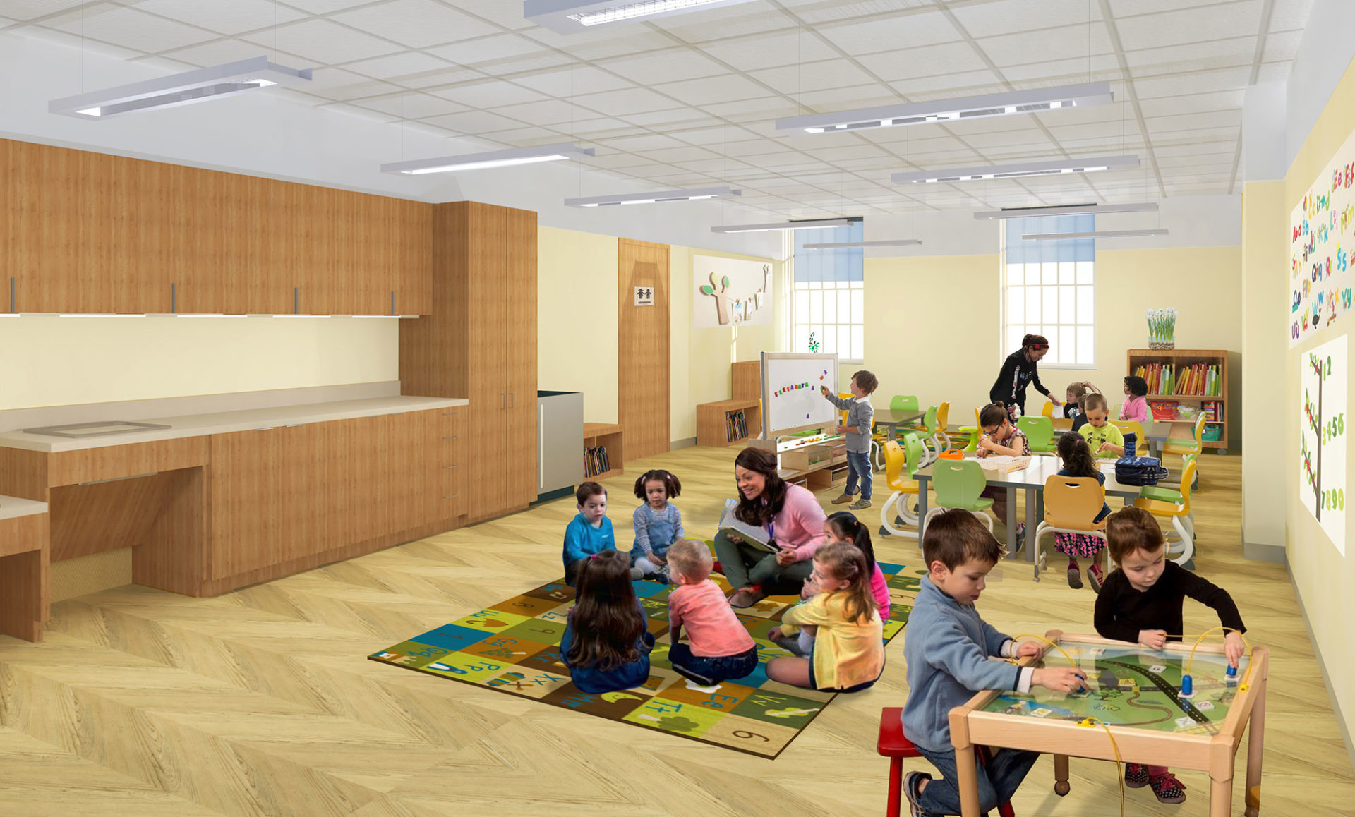
Question 4. Do we have sufficient classroom infrastructure to expand TK enrollments?
Classrooms for 4-year-olds are different: new plumbing, tiny furniture, easy access to outdoor space.
Excess classrooms or still building new facilities?
Is the district already sharing classrooms with nonprofit pre-K’s for full-day programming?
How do we access state facilities dollars (SAB), or advance local revenue bonds?

Slide 19
Crucial to recognizing differing local district conditions –
TK enrollments have grown at highly varying rates among small and large districts.
After initial expansion, TK enrollments leveled-off (before the pandemic).
TK serves large numbers of Latino children, small and leveling counts of White and Black children.

Slide 20
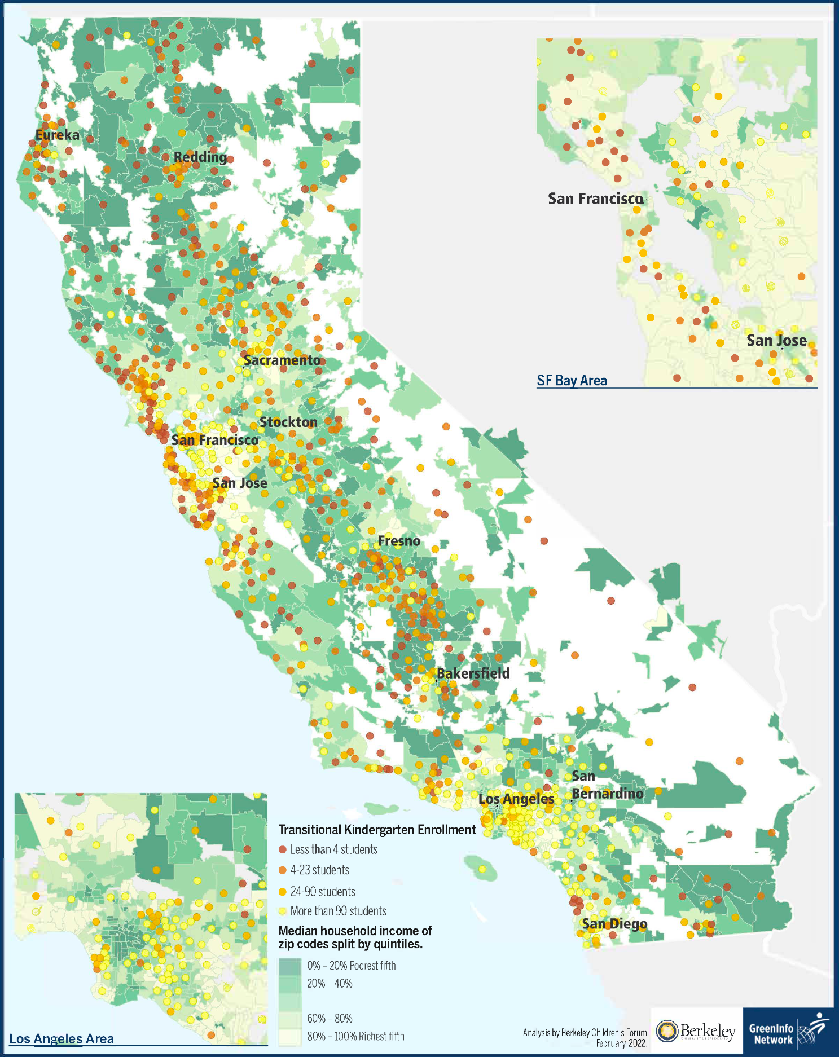
TK enrollment counts vary across California (2019-20)
TK enrollments are low in parts of the Bay Area, far northern counties, Fresno County, and much of the Central Valley…
While TK child counts are relatively high in L.A., Orange, and San Diego counties, along with districts in the East Bay.

Slide 21
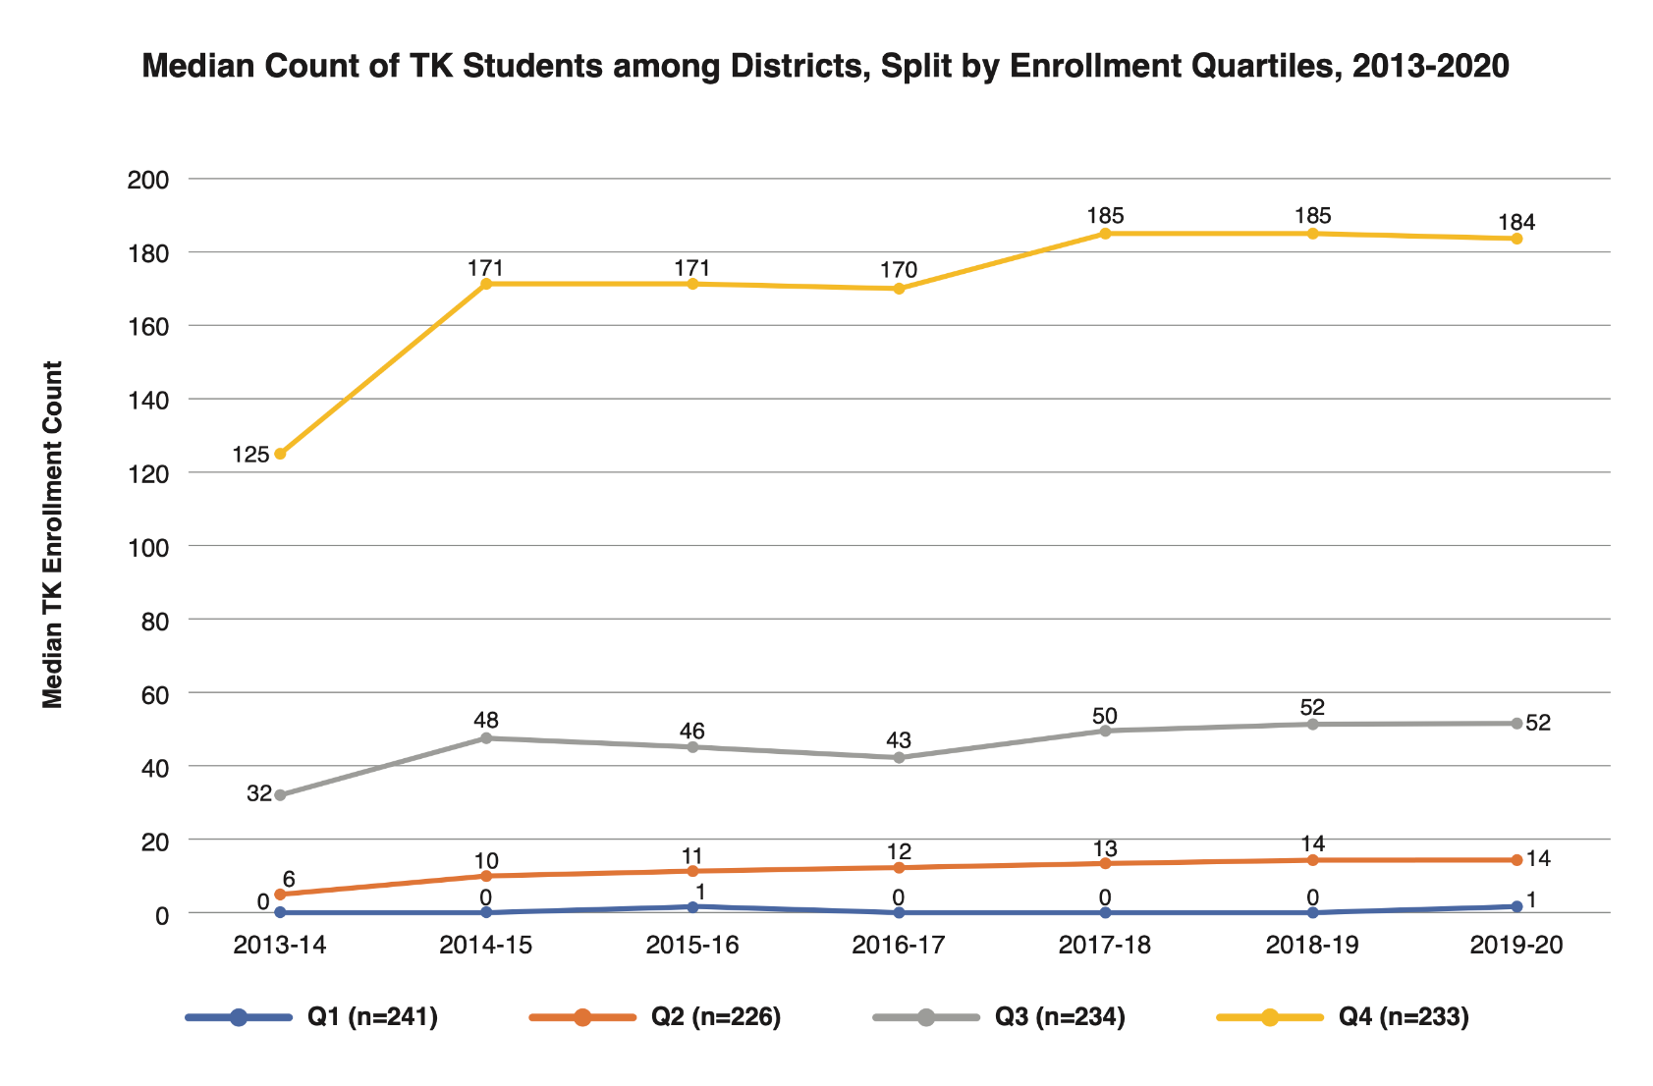
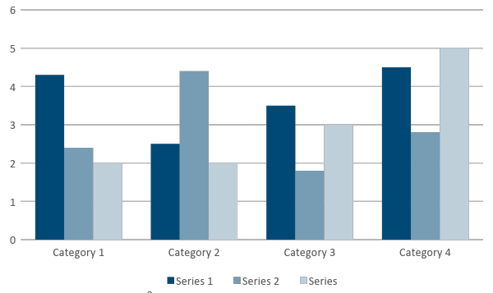
Median counts of TK children are low in the smallest one-half
of all California school districts, 2013-2020

Slide 22
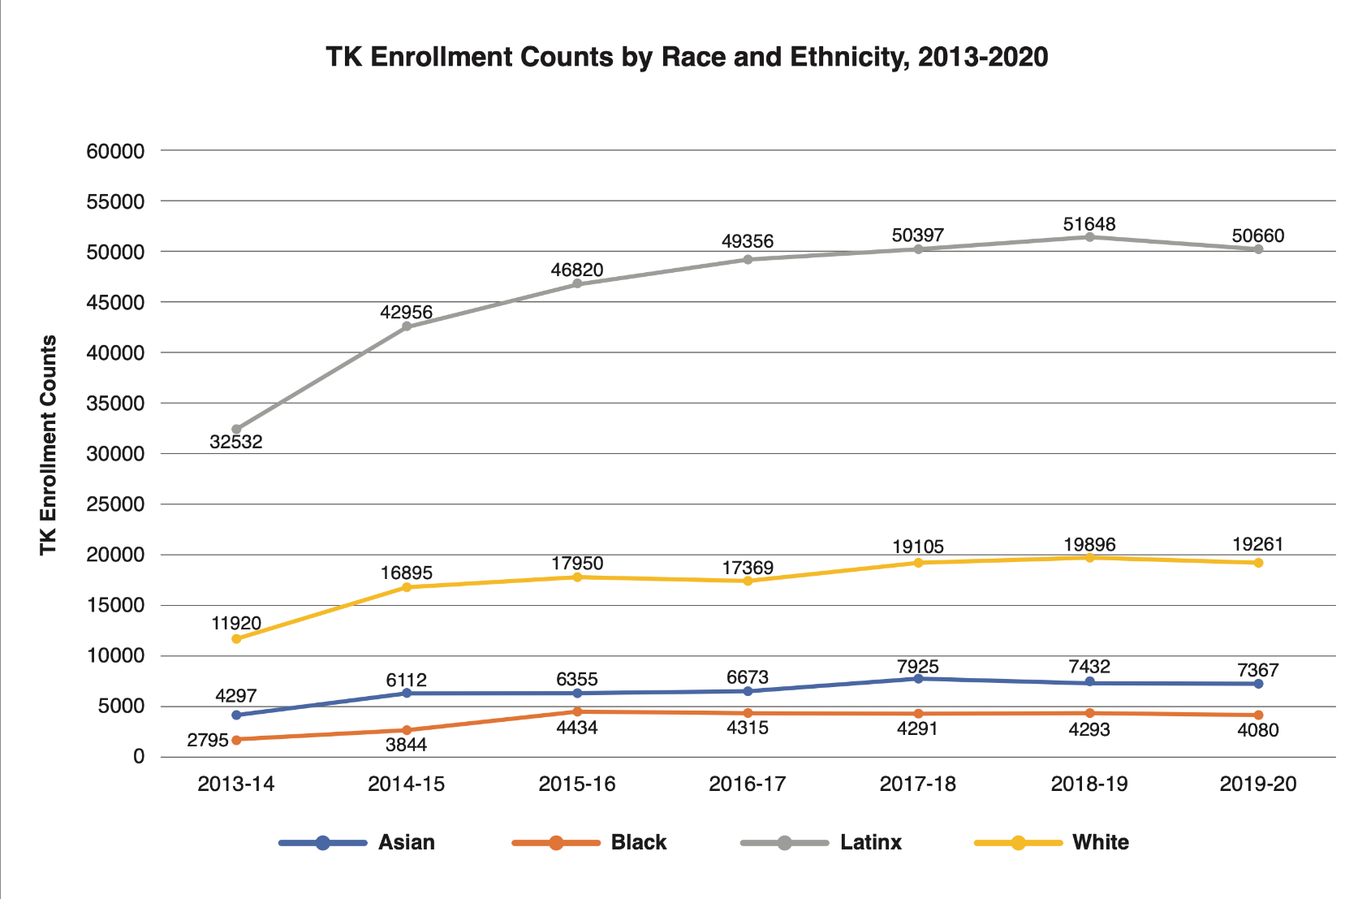
TK enrollment trends differ for child ethnic groups, 2013-2020

Slide 23
Moving forward…
How to plan for TK expansion coming off the pandemic, fiscal fluidity, and a teacher shortage?
Can we consolidate and integrate pre-K programs into the district’s core responsibilities… teaming-up with nonprofit partners in the community?
How to find sufficient teachers with experience in early childhood education?
Do we have sufficient classroom space and facilities dollars to serve more TK children?
And seek out advice from your county office of education, neighboring districts, and specialists… see CSBA brief.

Slide 24
A Discussion on Local Implementation
Dr. Stephanie Ceminsky
Sandra Lee

Slide 25
Guiding Questions
About your LEAs and your transitional kindergarten programs
When thinking through issues of curriculum and staffing, what approach are you using to incorporate existing PK-3 staff into expanded TK?
What strategies have you used to engage families and help them understand their TK options?
What lessons would you want LEAs implementing TK for the first time to know

Slide 26
CDE Guidance for UPK Planning, Implementation, and Alignment
Sarah Neville-Morgan, Deputy Superintendent- Opportunities for All Branch

Slide 27
UPK Plan Requirements
As specified in California Education Code (EC) 8281.5, LEAs must:
Develop a plan for consideration by the governing board or body at a public meeting on or before June 30, 2022 for how all children in the attendance area of the local education agency will have access to full-day learning programs the year before kindergarten that meet the needs of parents, including through partnerships with:
The local education agency’s expanded learning offerings
The After School Education and Safety Program (ASES)
The California State Preschool Program
Head Start programs,
And other community-based (CBO) early learning and care programs
Notes:
So, with this framing in mind, LEAs must develop a plan to articulate how they will implement UPK in their communities.
As specified in Education Code (EC) 8281.5, LEAs must: ​
•Develop a plan for consideration by the governing board or body at a public meeting on or before June 30, 2022, for how all children in the attendance area of the local educational agency will have access to full-day learning programs the year before kindergarten that meet the needs of parents, including through partnerships with:​
•the local educational agency’s expanded learning offerings, ​
•the After School Education and Safety Program, ​
•the California state preschool program, ​
•Head Start programs, ​
•and other community-based early learning and care programs.

Slide 28
UPK Planning Template Purpose
Created to: (1) offer planning questions for LEA consideration in developing comprehensive plans for UPK that meet community and family needs, and (2) outline the required data.
Vision & Coherence
In order to provide equity of access for all students and their families, it is vital for the LEA, in partnership with early learning and care programs, to develop a coherent educational system that begins with UPK, includes access to TK and other options for all four-year-old children, and provides full day programming through a combination of instructional time and extended learning and care opportunities for those families who choose this option.
In planning for UPK, consider how the LEA’s administrative structure will support school leadership in building connections between them and expanded learning programs as well as early learning and care programs (CSPP, Head Start, other subsidized or privately administered preschool and child care programs) to provide UPK programing and before school and after-school, intersession, and summer learning and care.
Notes:
The UPK Planning Template has been created to: (1) offer planning questions for LEA consideration in developing comprehensive plans for UPK that meet community and family needs, and (2) outline the data that will be required for submission to the CDE to meet the requirements of EC Section 8281.5.
Vision & Coherence
In order to provide equity of access for all students and their families, it is vital for the LEA, in partnership with early learning and care programs, to develop a coherent educational system that begins with UPK, includes access to TK and other options for all four-year-old children, and provides nine hours of programming per day through a combination of instructional time and extended learning and care opportunities for those families who choose this option.
In planning for UPK, consider how the LEA’s administrative structure will support school leadership in building connections between them and expanded learning programs as well as early learning and care programs (CSPP, Head Start, other subsidized or privately administered preschool and child care programs) to provide UPK programing and before school and after-school, intersession, and summer learning and care.

Slide 29
UPK Planning Template & Guidance
Resources to Support UPK Planning and Implementation
Local education agency (LEA) Planning Template
UPK Planning and Implementation Guidance Volume 1
Countywide Planning and Capacity Template only for County Offices of Education (COEs)
Where do these resources live?
https://www.cde.ca.gov/ci/gs/em/documents/finalupktemp.docx
https://www.cde.ca.gov/ci/gs/em/
https://www.caeducatorstogether.org/
Additional Guidance will be released soon:
Including P-3 assessments and curricula
P-3 Workforce
Notes:
To assist LEAs in creating their plans, we at the CDE have release a Planning Template and Guidance documents.
So listed here are some of the UPK resources already posted by the CDE on the Elementary webpage.​
1. The first resource listed is the LEA Template: The template includes​ planning questions for consideration to support developing comprehensive plans for UPK that meet community and family needs. These are optional questions and don't need to be returned to CDE​. There are also required questions which will be collected by the CDE after the plan is required to be submitted to the LEA's board, which is no later than June 30, 2022. Finally, there are also planning questions that we suggest in Appendix II for LEAs who want to go even deeper in their planning. The template was informed by CDE staff and external partners, including a workgroup comprised of early education implementers including TK, Head Start, CSPP, and early learning and care programs operated by CDSS. ​You can find the UPK Planning and Implementation Grant Program Planning Template or as we will continue to refer to throughout this presentation as the UPK Planning Template, is located at https://www.cde.ca.gov/ci/gs/em/documents/finalupktemp.docx . We'll also put the link in the chat. ​​
2. The second resource is the guidance document focusing on community engagement and partnerships. This guidance document corresponds to the template for local education agencies (LEAs) to implement UPK. It also introduces early education concepts, research, resources, programs, partnership opportunities, and policies. Both the Template and Volume 1 of the Guidance can be found on https://www.cde.ca.gov/ci/gs/em/. The Guidance can also be found on California Educators Together (caeducatorstogether.org).​
3. The third resource is the Countywide Planning and Capacity Template only for County Offices of Education (COEs). The CDE developed a template for ​
COEs that receive funding to provide countywide capacity and support. COEs in each county are funded to provide planning and capacity building for UPK, which includes supporting partnerships. We know that at the COE level, there are multiple systems that are currently seated at the COE, including the vast majority of the Local Planning Councils and many Resource and Referral and QCC leads.​ The COE planning template, includes: (1) planning questions for COE consideration in developing plans for how they will support LEAs in their county to plan and implement UPK in a way that meet community and family needs, and (2) Data that will be required for COE submission to the CDE to meet the requirements of EC Section 8281.5.​
We will be releasing Volume 2 of the Guidance soon, which will address many topics, but one topic– which we will preview today– is on UPK curricula, and how to think about this in a P-3 lens.
​ ​

Slide 30
P-3 Alignment Efforts: Foundations, Assessments, Curriculum, and Workforce
Notes:
SARAH
So, there is a lot to think about around planning for UPK, and keeping in mind this vision for P-3, but one of those intersection points we wanted to highlight today is UPK foundations, assessments, curricula and the workforce. And how to think about P-3 alignment with these realms.

Slide 31
P-3 Alignment with Curricula
At this time, the CDE cannot endorse or recommend a specific curricula for use in preschool, TK, or across the P-3 space
We are hoping to develop a plan to address this issue as we continue our work in aligning foundations and assessments in P-3
But we do have recommendations for best practices in P-3 curricula
“Whole-child” curricula have their strengths and weaknesses
Intentional learning opportunities with a dedicated scope and sequence
Mix of teacher and child-led learning experiences
More time in centers and small-group; Less time in whole-group
Embedded assessments; opportunities for individualization
Engaging and culturally relevant themes
Explicit support for home language, and including children with disabilities
Joint professional learning with P-3 teachers to ensure that curricula seamlessly build upon each other
Notes:
SARAH:
We also have our work with curricula.
At this time, the CDE cannot endorse or recommend a specific curricula for use in preschool, TK, or across the P-3 space. We are hoping to develop a plan to address this issue as we continue out work on aligning early learning standards with assessments in P-3
.But we do have some general recommendations for best practices in P-3 curricula.
One, we want to acknowledge that whole-child curricula have their strengths and weaknesses.
A whole-child approach is driven by child-centered learning that encourages independent play and exploration through activities across multiple domains such as social-emotional, language, science, literacy, and math. In theory, the whole-child approach is developmentally appropriate for preschool-aged children, but in practice, research has demonstrated that this approach alone falls short in meaningfully building upon children’s key school readiness skills. Many commercially available preschool curricula are advertised as “whole-child” or “comprehensive” but may not provide teachers with explicit guidance on how to intentionally build upon skills, especially in math and literacy. For example, these curricula typically provide math activity options that span the appropriate math domains of children’s learning, but there is limited direction on the sequence of introducing different math topics, and activity examples lack guidance on how to individualize activities for different children depending on their developmental level.
This is why the addition of skills-specific curricula is critical to fortifying a teacher’s whole-child approach in the classroom. Skills-specific curricula typically include scripted activities that provide guidance on “where to start”, and “what comes next” within a specific learning domain. For example, in a “whole-child” curricula math activity, teachers may encourage children to engage in an exploration of patterns in their environment and re-create these patterns using colored paint. While this activity reflects a developmentally friendly approach, it may be too open-ended for children to meaningfully understand what patterns are, which can create subsequent difficulty for teachers to individualize and scaffold this skill. As a result, children will not have the potential to master this critical skill within the math domain.
It’s also important for there to be a mix of teacher and child-led learning experiences, more time in centers and small-group and less time in whole-group. This format also lends itself more easily to embedding of assessments and opportunities for individualization based on a child’s assessment results.
Curriculum themes are also a great opportunity to incorporate more culturally relevant topics, and present opportunities for supporting children’s home language, and including children with disabilities.
And lastly, professional development on curricula should span the early grades so that there is seamless alignment from one grade to the next. We’ll touch briefly on the P-3 efforts underway for the workforce

Slide 32
P-3 Alignment with the Workforce
Staffing TK –Credentialed Teacher:
https://leginfo.legislature.ca.gov/faces/codes_displaySection.xhtml?sectionNum=48000.&lawCode=EDC
Complete at least 24 units of ECE or CD OR;
Experience in classroom setting with preschool age children comparable to 24 units OR;
Hold a Child Development Permit at the Teacher level
P-3 Credential – Retooled Early Childhood Specialist Credential
Credential to teach in P-3 grades
CTC with input from a workgroup developing requirements
Update on this credential at tomorrow’s CTC meeting
Workforce Support
Golden State Teacher Grants
Residency Grants
Classified School Employee Teacher Credentialing Grants
Educator Effectiveness Block Grant
Early Education Teacher Development Grant
Notes:
We are also aware that in order to have alignment with curricula and learning standards, the workforce must also be aligned. This begins with staffing for TK, and ensuring that we are getting teachers that can support the developmental needs of four-year olds
Staffing TK:
Currently, only a credentialed teacher is authorized to teach TK
Starting with the 2023-24 school year, in order to receive apportionment funding for TK classes, Education Code 48000(g)(4) requires LEAs to verify that credentialed teachers who are first assigned to teach TK after July 1, 2015, have one of the following:
(a) completed at least 24 units of early childhood education or early childhood education at a regionally accredited institution of higher education, or
(b) experience in a classroom setting with preschool age children that is determined by the employer to be comparable to the 24 ECE units, or
(c) hold a Child Development Permit at the Teacher level issued by the Commission on Teacher Credentialing (CTC).
*When an LEA has exhausted all options for hiring a fully credentialed TK teacher; flexibilities exist like an intern, such as an intern credential, provisional internship permit, short term staff permit, variable term waivers, and local assignment options
ECE Specialist Credential:
A workgroup has been charged by the Commission with developing recommendations to retool the existing Early Childhood Specialist Credential to become a credential that authorizes service teaching in Prekindergarten through third grade. The workgroup will develop and recommend Teaching Performance Expectations, Program Standards, and an Authorization statement for consideration by the Commission in Spring 2022.
The Commission expects the retooled Early Childhood Specialist Credential to have expedited pathways for current holders of a Child Development Teacher Permit who also have a bachelor’s degree, and for Multiple Subject Credential holders seeking to add an ECS authorization to their existing credential. CTC will provide an update on the ECE teacher credential at their meeting tomorrow, April 8: https://www.ctc.ca.gov/commission/agendas/2022-04/april-2022-commission-meeting
There are a multitude of credentialing supports for the workforce such as the Golden State Teacher Grants which is $20,000 for completing an approved preparation program​, Residency Grants which are $25,000 to support a resident in completing an approved preparation program, the Classified School Employee Teacher Credentialing Grants which is $24,000 to support classified staff in completing bachelor’s degree and an approved preparation program, the Educator Effectiveness Block Grant which is $1.5B for LEAs ​, and the Early Education Teacher Development Grant which is $100M for LEAs​

Slide 33
P-3 Alignment – Updates
Work is underway to revise and extend the Preschool Learning Foundations (PLF)
Update the Desired Results Developmental Profile (DRDP) to reflect updates to the PLF, to be used in preschool and TK settings
Add direct assessments of math and literacy, extend these direct assessments to second grade
In addition to direct assessments in math and literacy, consider extending the DRDP in some domains-- like social-emotional and approaches to learning skills-- for use in kindergarten, first, and second grade
Notes:
SARAH:
So we cannot talk about curriculum without acknowledging early learning standards that curricula must be aligned with. Work is currently underway to revise and extend the Preschool Learning Foundations and revisions will include updates to the research on child development across the PLF domains– which include, math, language and literacy, science, social-emotional, English language development, social science, visual and performing arts , physical development, and health development.
We will be incorporating more culturally inclusive examples across the milestones within each domain to address racial and cultural bias
We will add an Approaches to Learning domain to highlight children’s executive functioning and self-regulation skills, which will align more with the DRDP.
And tailor the foundations to explicitly address supporting the development of dual-language learners and children with disabilities across each domain
We also have plans to extend the preschool learning foundations which will include a P-3 development guidance across the domains of math, literacy, language, science, social-emotional skills and approaches to learning
The hope is for this resource to aid P-3 educators in understanding the developmental progress of key skills

Slide 34
Universal TK
CSBA’s Legislative and Budget Perspectives
Chris Reefe

Slide 35
Implementation Challenges Remain
Facility capacity is a significant barrier to successful implementation
Current year budget provides $490 million to support the construction and renovation of state preschool, transitional kindergarten and kindergarten facilities.
Although helpful, it is inadequate to meet demand.
All LEAs need access to funding in order to fulfill the state’s goals for TK expansion

Slide 36
TK Facilities Challenges Continued…
Previous local bonds typically do not include authority to construct TK facilities and the existing facilities program requires a local match component with limited available funding split between two other competing priorities (Full-Day Kindergarten and Pre-School).
TK Facilities face unique challenges beyond what is required for typical K-12 classrooms.
They are unique in that they must also meet Title 5 (Child Care) Program requirements.

Slide 37
Additional challenges…
Teacher shortage increases challenge on staffing TK Classrooms
According to the CA Commission on Teacher Credentialing’s August 2021 Meeting, at full implementation the state will need up to 11,000 teachers to staff TK classrooms statewide.
Multi-Delivery System approach remains a topic of discussion
Role of Community Based Organizations and existing Early Care and Education Infrastructure continue to be discussed – General Child Care, Head Start, State Preschool Program, etc.
School Transportation Funding needs remain
CSBA continues to advocate for increased funding for school transportation funds, including 100% of costs and a COLA.

Slide 38
Community Funded Districts
Community Funded Districts, AKA Basic Aid Districts do not receive additional funding to provide Universal Transitional Kindergarten.
As it sits now, these districts absorb these costs by redirecting funds from existing programs.
CSBA has and continues to advocate for additional funding for Community Funded Districts to help fund the provision of Transitional Kindergarten.

Slide 39
CSBA UTK Resources
The video and slide deck from this webinar
A governance brief written by Bruce Fuller and Abigail Slovick
Quick facts on UTK
Data on the current state of UTK in California
Two examples of districts who enacted UTK
Available at the CSBA UTK Landing Page (linked here)
Notes:
The landing page is hyperlinked

