Slide 1
Local Control Funding & Accountability A Community Conversation
Name of District /LEA
Day , Date
Notes:
Welcome
Purpose
Logistics: Restrooms, Water/food as appropriate, child care as appropriate

Slide 2
Our Agenda
Money Local Control Funding Formula
Planning Local Control Accountability Plans
Timeline When decisions must be made
Governance The board’s role
Status Current reality of our district
Input Thoughts of the community

Slide 3
LCFF Quiz
1. LCFF increases our district revenue this year by:
5% b. 12% c. * correct d. 24%
2. The district will get the money in:
Nov b. for Xmas c. Feb d. June
3. LCFF guarantees funding for schools.
a. True b. False
Notes:
NOTE: District’s need to add the correct answer to #1 C.

Slide 4
How LCFF Works
Notes:
Money

Slide 5
Key Precepts of LCFF
Based on specific considerations:
Equity, additional resources for students with greater needs
Low-income students
English learners
Foster youth
Local decision-making and stakeholder involvement
Accountability
Transparency
Alignment of budgeting with accountability plans
How LCFF Works
Notes:
Important to understand the principles that are behind the LCFF leglislation

Slide 6
2020-21 Target Base Funding
School Districts & Charter Schools
How LCFF Works
Notes:
the numbers are the State's
They are subject to change:
by actual apportionment numbers
by possible future legislative action
By changes in state revenue
Every student generates a base grant.

Slide 7
2020-21 Target Supplemental Funding
School Districts & Charter Schools
How LCFF Works
Notes:
the numbers are the State's
They are subject to change:
by actual apportionment numbers
by possible future legislative action
By changes in state revenue
Every Low Income, Foster, or English Language Learner student generates a supplemental grant, in addition to the base grant.

Slide 8
2020-21 Target Concentration Funding
School Districts & Charter Schools
How LCFF Works
Notes:
the numbers are the State's
The concentration grant kicks in when Low Income, Foster, or English Language Learner students make up more than 55% of the enrollment.
These students generate a concentration grant, in addition to the base and supplemental grant.
EXAMPLE:
IF LI, Foster and EL students make up 75% of the district, the first 55% would generate a base and supplemental grant, the additional 20% would each generate a concentration grant as well.

Slide 9
The Caveats
The targets are subject to change:
by actual apportionment numbers
by possible future legislative action
By changes in state revenue

Slide 10
Local Control & Accountability Plans (LCAPs)
Notes:
Money

Slide 11
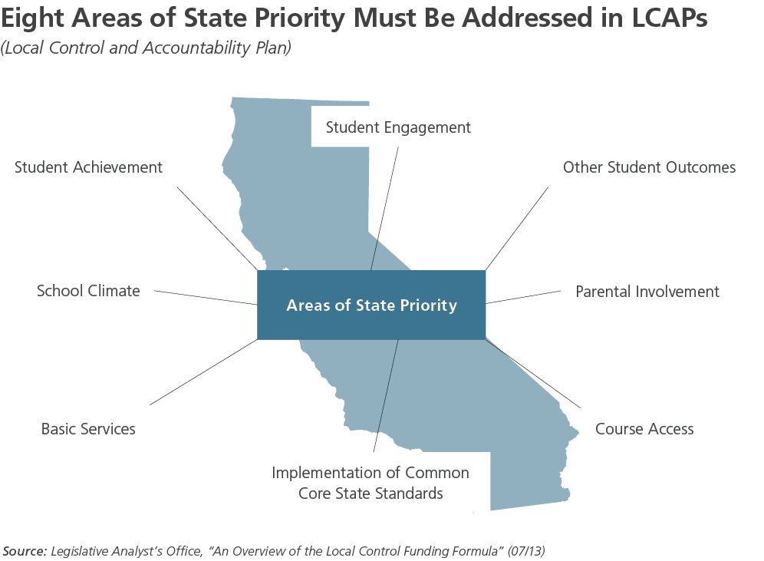
Local Control & Accountability Plans (LCAPs)
Local Control & Accountability Plans (LCAP)

Slide 12
Local Control Accountability Plans
Local boards must adopt LCAP on or before July 1, 2014.
LCAP shall be for 3-year periods and be updated annually.
Plans must:
Include annual goals for all pupils and each subgroup each of the eight state priorities
Specify the actions the LEA will take
The expenditures budgeted for these specific actions
The expenditures that will serve pupils in the target groups and pupils reclassified as fluent English proficient.
Be aligned to the LEA budget
Local Control & Accountability Plans (LCAP)
Notes:
See EC 52060. The LCAP must adhere to the SBE-adopted template. SBE to adopt the template by March 30, 2014.
The term “state priorities” is used in the LCFF statute (new EC 52060).
Course of study as described in Ed Code Sections 51210 (grades 1 – 6) and 51220 (grades 7 – 12)

Slide 13
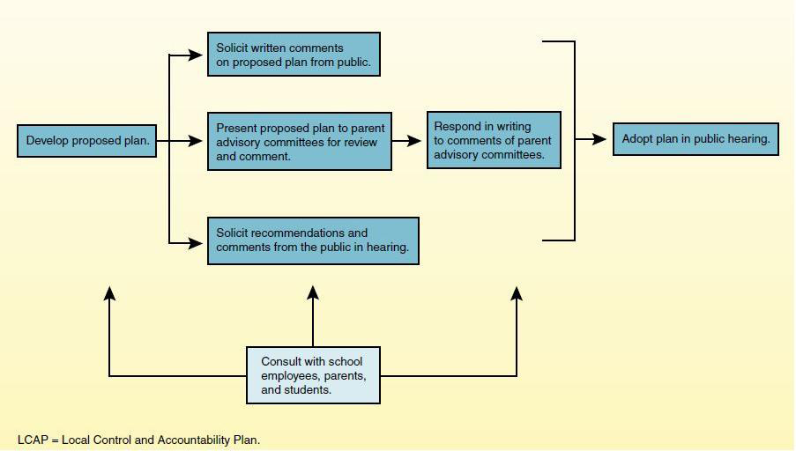
Planning Process
Notes:
Source: Legislative Analyst’s Office
Refer to Local Control Accountability Plans and
Community Consultation handout

Slide 14
Timeline
Notes:
Money

Slide 15
LCFF Timeline
January 2014
State agencies update standards for adoption of local budgets
State Board adopts regulations on expenditure of supplemental and concentration funds
Changes recommended to revise the Academic Performance Index
March 2014
State Board adopts template for Local Control and Accountability Plans (LCAPs)
June/July 2014
Local educational agencies have established local policies to implement
Local educational agencies adopt LCAP aligned with budget
October 2015
State Board adopts rubrics for evaluation and technical assistance
What now?
Notes:
The Public Schools Accountability & Assessment Advisory Committee to make recommendations to revise the API in accordance with LCFF and SB 1543 Steinberg.
Rubrics to be used by districts, counties and charter schools to evaluate their strengths and weaknesses in meeting LCAP goals. County superintendents, State Superintendent and California Collaborative for Education Excellence to use rubrics to identify areas in need of technical evaluation.

Slide 16
Role of the Board
Notes:
Money

Slide 17
Role of the board & LCFF
What does the law say schools must do.
Legal Requirements: State and Federal Law, CA Ed Code, NCLB, etc.
What does the community want its school to do.
The community: its values, priorities, concerns and interests.
The services we provide to students
LEA Resources: Human, financial, and material assets.
What does the LEA have the capacity to do.
Professional Research & Literature
What does the profession say the schools ought to do.
Governance Implications & Considerations
Notes:
It helps the community to understand the roles of the board., and how these roles can be in conflict.
The four roles describe four major factors that influence board decision-making.
Upper right corner of the screen
WANTS – This is the boards REPRESENTATIVE role – to understand what the community whats for its schools.
We wanted to start the conversation early with you, so that we have a chance to understand your thoughts, interests and ideas.
Tonight we are focusing on this – what the community wants.
Upper left corner of the screen
MUST – This is the boards INSTRUNMENTAL role. Boards are required by law to do certain things. We know a little bit about what the accountability requirements are, but the regulations are still being developed.
Lower left corner of the screen
CAPACITY – This is the board’s FIDUCIARY role. Board are required to balance budgets – and ensure the long term stability of the district. When we have more information about how much money is coming, we will have a better sense of what we have the capacity to do.
Lower right corner of the screen
OUGHT – This is the role of the board that deals with governing an institution that employs professionals. People with special training, knowledge and experience. The board looks to the superintendent and district staff and says, “given the research and our local needs, what should we do?”
Board must balance these roles in making decisions that serve students best.

Slide 18
Status of our District
Notes:
Money

Slide 19
Who our students are
District insert local data
Notes:
Insert graph of key demographic data here

Slide 20
How students are doing
District insert local data
Notes:
Insert graph of key academic indicators here

Slide 21
Few Categorical Programs Remain
13 programs remain, and their funding remains restricted – you must run the program to receive the funds.
Not all program funding covers the full cost of the program
How LCFF Works
Notes:
Districts may wish to utilize the Program Overview handout #2
The purpose is to have the community understand how the elimination of the restricted funding creates opportunities for creative solutions.
District will need to add their local data to the handout.

Slide 22
Community Thoughts
Notes:
Money

Slide 23
Community thoughts
Please think and talk about four questions:
What has worked well that should continue / expand?
What has promise, but needs to be improved?
What programs don’t work and should be stopped?
What programs / services should we start?
Notes:
Please see Forum Plan.
Depending on the number of participants, you may want to have small group discussions.

Slide 24
Thank You
Notes:
Money

