Slide 1
Behind the Numbers
The cold, hard facts of California Public School Funding
California School Boards Association
www.csba.org

Slide 2
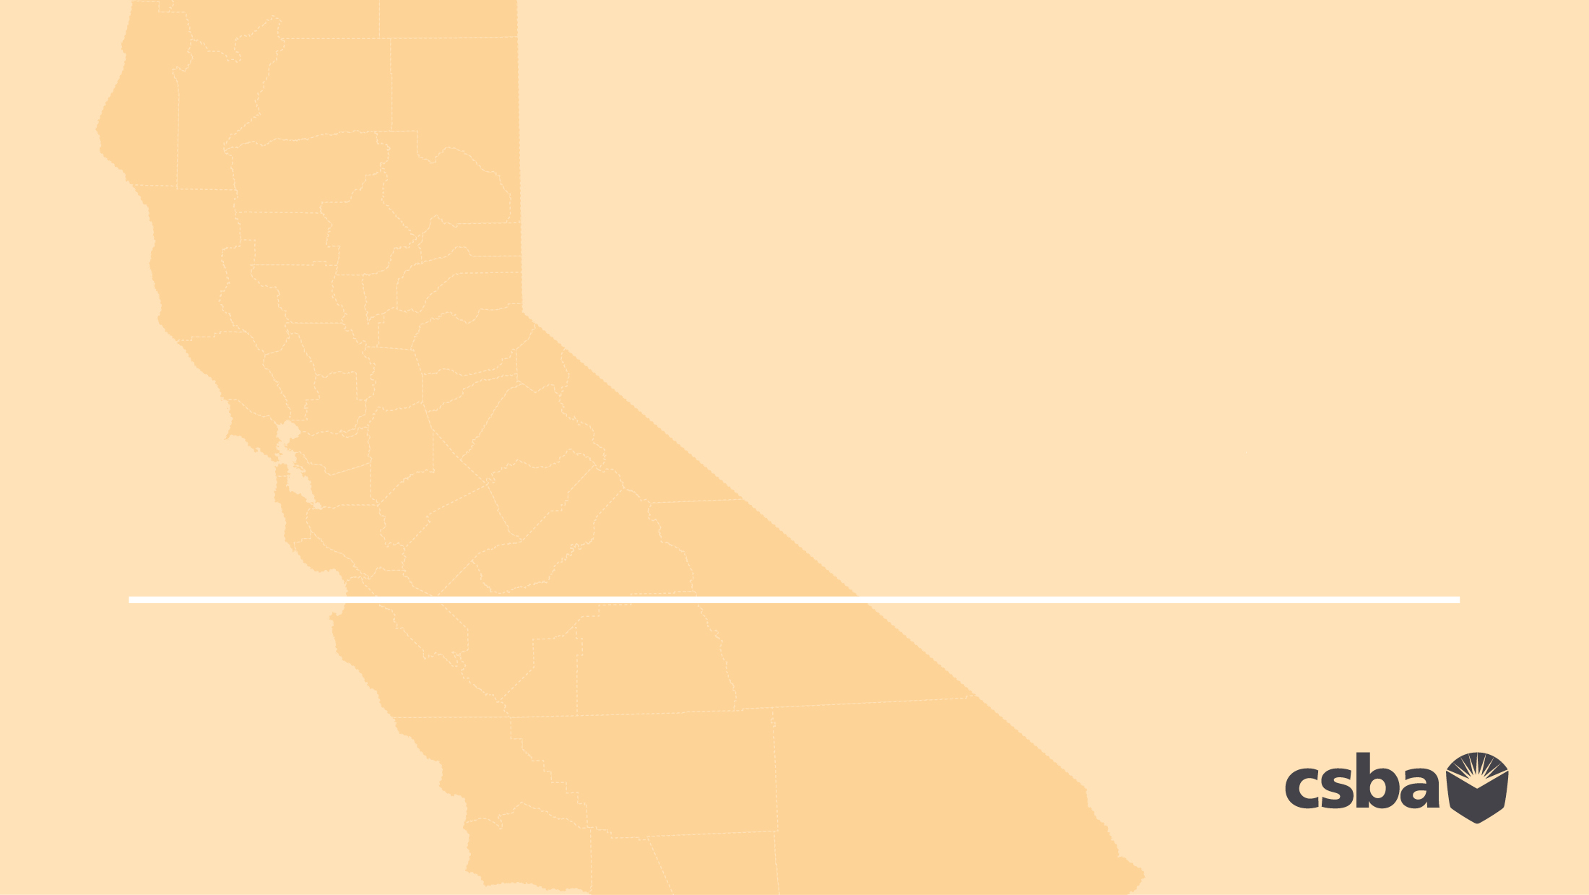
California has the 6th largest economy in the world and the largest GDP of any state, yet ranks near the bottom in nearly every measure of school funding or school staffng.

Slide 3
45th in percentage of taxable income spent on education

Slide 4
Despite recent improvements through LCFF, California ranks near the bottom nationally in public school investment, both in terms of final resources and in terms of staffing.

Slide 6
LCFF restored some of the funding lost during the Great Recession, yet, in many cases, those gains are being eroded by increases in health care, pension and utility costs that threaten to put many districts and county offices underwater.
California’s inadequate school funding hurts our students, undermines our communities, threatens our prosperity, and dims the prospects of future generations.

Slide 7
If we want to prepare our students for an increasingly competitive, technology-driven global economy, we must invest at a level necessary to support student success.

Slide 8
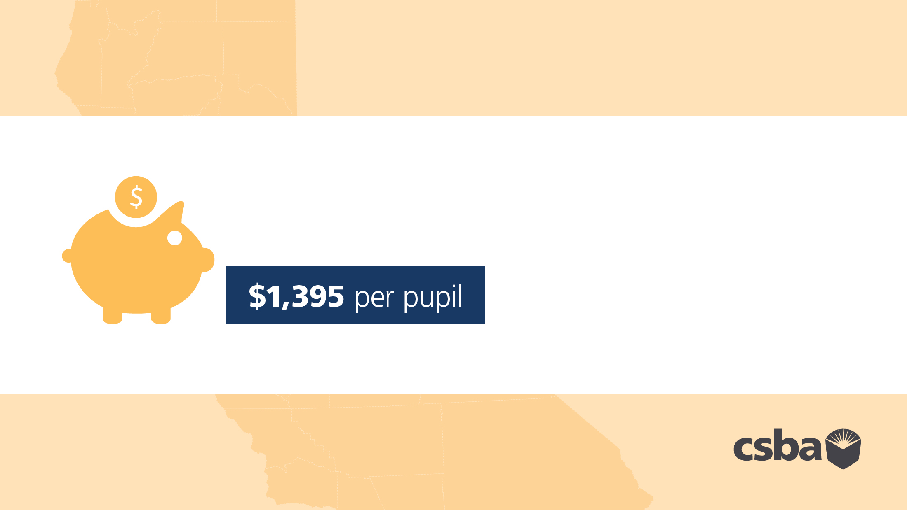
If the state funded schools at just the national average, that would increase funding by

Slide 9
For a classroom of 25 students, that’s an additional

Slide 10
With an additional $1,395 per student, a 500 student school would have $697,500 in additional revenue. This would allow the school to:
» Improve College and Career Counseling, Engage Parents, Ensure Advanced Placement Success, Provide a
Well-Rounded Education, Expand Summer Learning and Expand Preschool

Slide 11
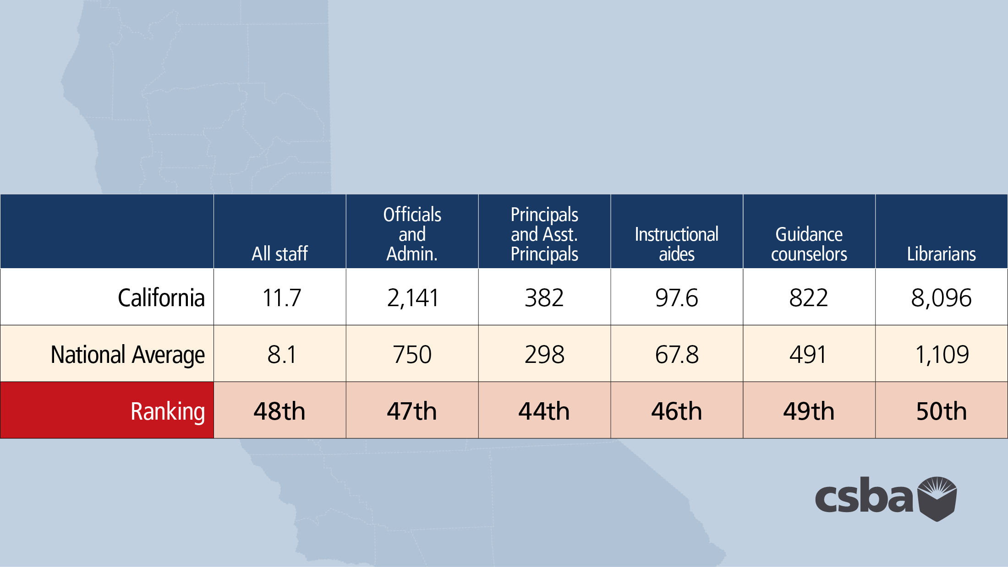
California has one of the worst teacher-pupil ratios in the nation
…and some of the lowest overall staffng levels in the country

Slide 12
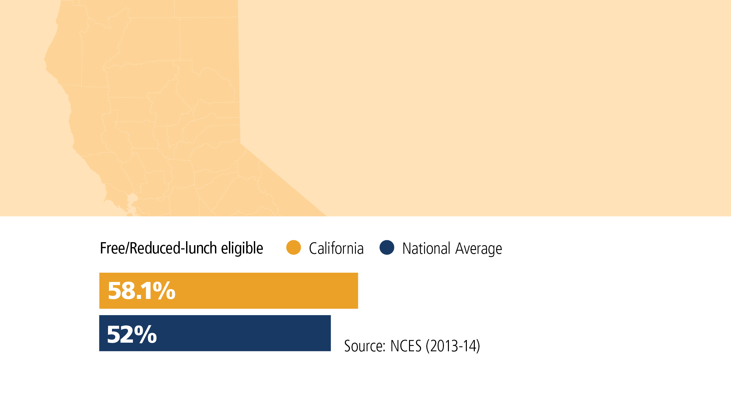
The problems posed by California’s dismal school funding levels are compounded by the high level of student
need and the state’s high cost of living: 58 percent of California’s public school students are eligible for free/
reduced lunch — above the national average of 52%

Slide 13
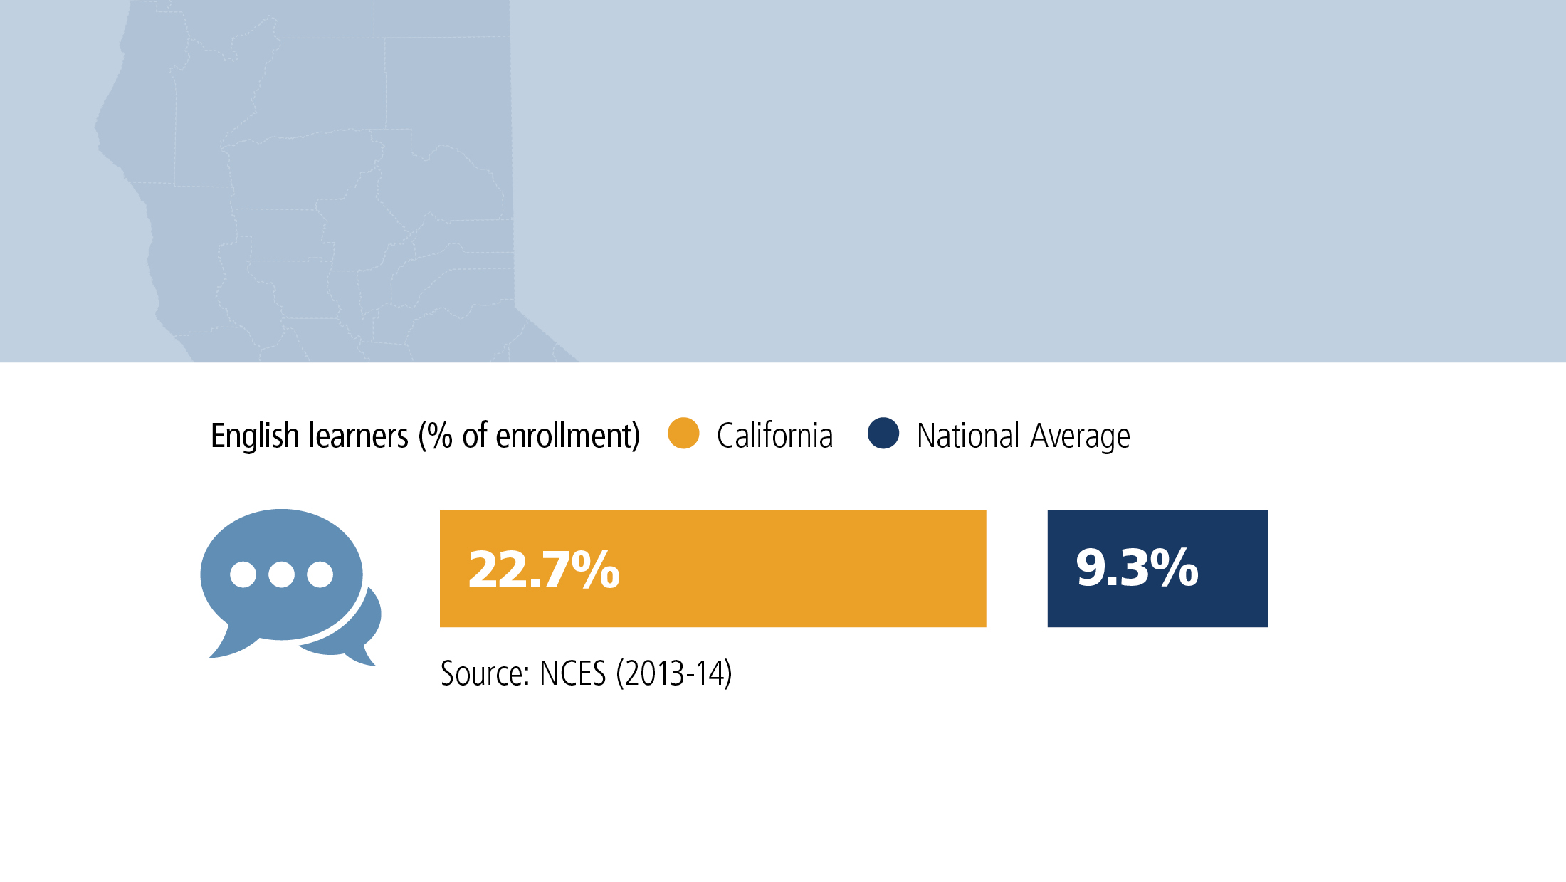
California also has the nation’s highest percentage of English Learner students at 23% — more than twice the national average of 9%

Slide 14
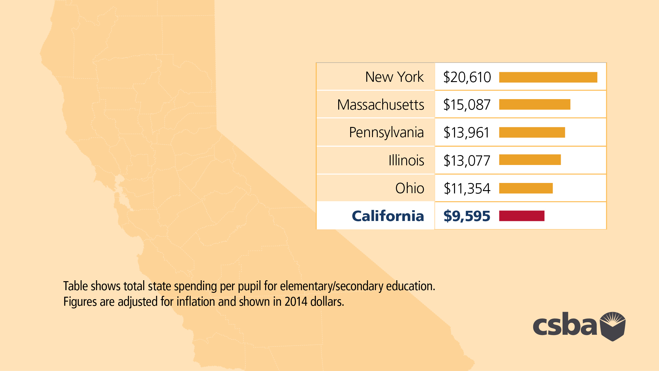
California trails peer states in per pupil spending and provides just a fraction of the funding offered by the nation’s top 10 states.
In fact, some states spend nearly twice as much per pupil as California.

Slide 15
LCFF is a step forward philosophically because it supports equity by directing more money to students with higher need. But redistribution is a not a solution when the overall funding pie is much too small.

Slide 16
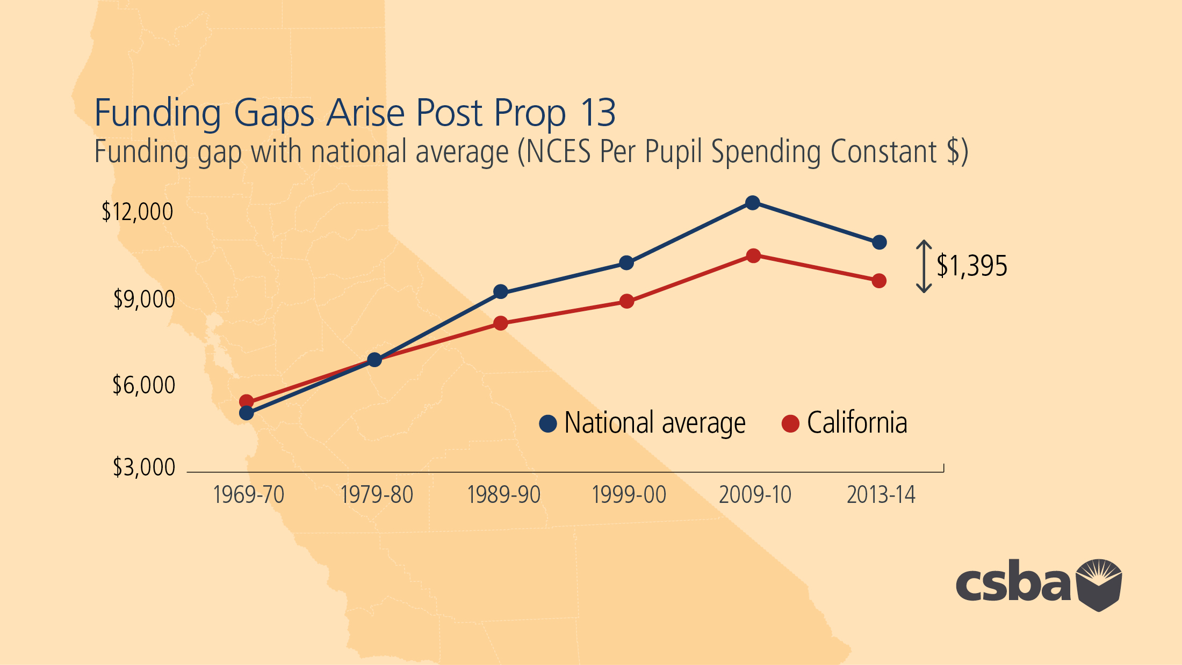

Slide 17
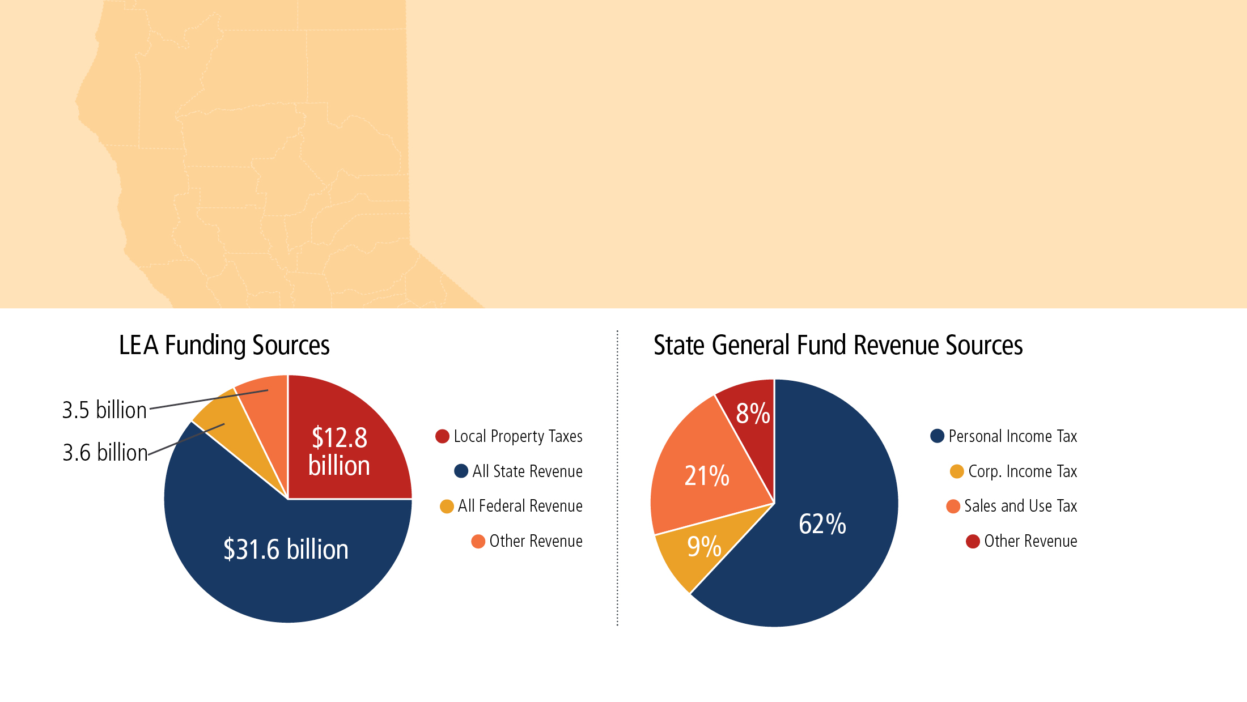
We need to do more than cut the same size pie into smaller and smaller pieces. We need to increase the funding pie to a level that that will allow us to serve all students and prepare them for college, career and civic life.

Slide 18
The urgency of investment in public schools is only growing as:
Revenue increases scheduled from LCFF have nearly expired
Employer pension contribution costs are set to double over the next five years
Health care, utility, transportation and special education costs continue to skyrocket
Unfunded mandates are introduced annually
The next recession grows closer

Slide 20
California has consistently underfunded public education while widening its scope, adding new requirements and raising the standards for what constitutes 21st Century Learning. As a result, our schools lack the resources of those in poorer sections of the country as well as the resources needed to meet the state’s goals for students.

Slide 21
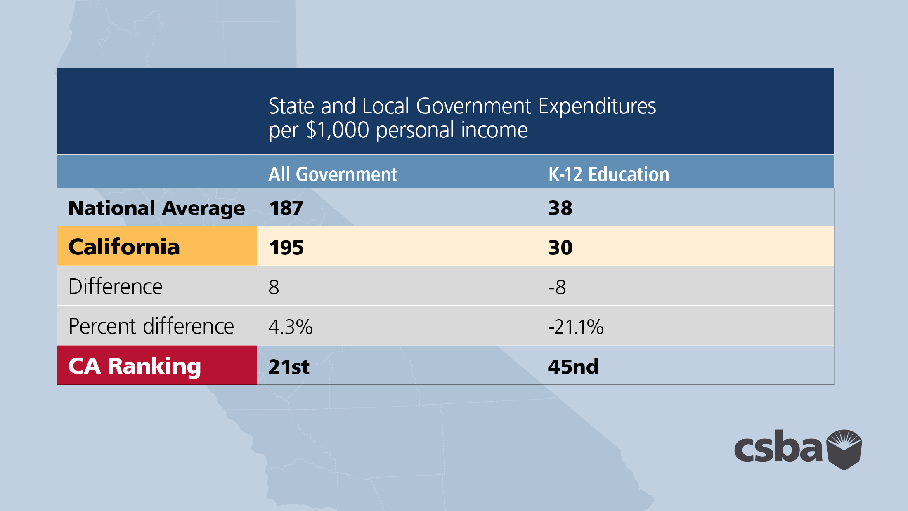

Slide 22
Districts are doing more with less, but if California is serious about providing all its children with a high-quality education, we need to get serious about full and fair funding for public schools.

