Slide 1
CORE ESEA Waiver Resubmission Summary
May 2013

Slide 2
Current ESEA (NCLB) law demands 100% proficiency by 2014 and loss of funding and one-size-fits-all interventions for schools that do not meet the target
Adequate Yearly Progress (AYP) Target
for High School ELA, 2002-2014
No Child Left Behind (NCLB), formally known as the Elementary and Secondary Education Act (ESEA), mandates that all students are academically proficient by 2014
  Schools, LEAs, and subgroups must meet these goals to make AYP targets and exit Program Improvement
  NCLB neglects subjects like social studies, the arts, health and physical education
  The penalty for missing AYP is loss of federal funding for schools serving low-income children
ESEA expired in 2007, and Congress hasn't acted to rewrite or refresh it
In 2011, the US Education Department told states that they could apply for waivers pending a new law because the current law was "forcing districts into one-size-fits-all solutions that just don't work"
Current School Year
ESEA Authorization Expired
California LEAs and schools must meet Participation Rate, ELA, Math, API, and Graduation Rate targets for all students and subgroups under NCLB to be considered making AYP
Source: USED; CDE, NBC News

Slide 3
USED offers a waiver for ESEA requirements; California is one of five states that does not have an approved ESEA Flexibility Waiver or one under review
States approved for ESEA flexibility (n=34)
States with ESEA flexibility requests under review (n=14)
District of Columbia
Puerto Rico
Bureau of Indian Education
Source: USED

Slide 4
CORE’s Waiver Goal
With this waiver, CORE does not seek to escape FROM accountability. Instead, CORE is asking for a waiver INTO a new system with a higher level of shared responsibility and accountability but propelled by the right drivers to achieve the system’s ultimate purpose:
All students prepared for college and careers
Elimination of disparity and disproportionality on multiple measure of student engagement and success.

Slide 5
The large achievement gaps in CA’s student subgroups are a call to action: Change is needed to address this disproportionality, as the status quo is not working
California’s population of historically underperforming subgroups is large
“At more than 6 million students, California’s public school population is enormous. It is also enormously diverse. In its schools, the state has a majority of minorities, with Hispanics/Latinos making up the largest student group”
“More than one in five children in California live in poverty, and nearly half of all K–12 students participate in the federal free and reduced-price meal programs offered in schools to students from low-income families”
“In addition, one quarter of California’s K–12 students are English learners”
—EdSource, “The Achievement Gap in California”
California’s subgroups underperform from starting KG to entering college
“On the National Assessment of Education Progress (NAEP) and California’s own standards-based tests (CSTs), poor students, African Americans and Latinos, and English learners are over-represented among students scoring at the lowest levels and under-represented among the highest scoring”
“Other measures of student achievement—including dropout and graduation rates, completion of the A-G courses required for eligibility to the state’s four-year universities, and college admissions—reveal similar achievement patterns between these groups of students and their peers. These results are important because they predict later success, including students’ ability as adults to secure jobs that pay a living wage”
“Because African Americans and Latinos in California represent disproportionate numbers of children living in poverty, they are also more likely to begin school at a disadvantage”
—EdSource, “The Achievement Gap in California”
An ESEA waiver can help Participating LEAs address the problem of disproportionality among California’s student population by highlighting schools with large achievement gaps and providing targeted interventions
Source: EdSource website

Slide 6
CORE Waiver LEAs have agreed to lower subgroup N-size to 20, increasing accountability for a significant number of additional students
Additional Students Counted Under N≥20 Recommendation, California (all districts)
Based on 2005-2006 student figures
State ESEA Waivers With Lowered N-Sizes
State | Original N-Size | New N-Size
Arkansas | 40 | 25
Connecticut | 40 | 25
Delaware | 40 | 30
Idaho | 34 | 25
Mississippi | 40 | 30
Nevada | 25 | 10
North Carolina | 40 | 30
Rhode Island | 45 | 20
South Carolina | 40 | 30
South Dakota | 25 | 10
Virginia | 50 | 30
Washington | 30 | 20
Wisconsin | 40 | 20
CORE Waiver LEAs | 100 | 20
Subgroup | Students Counted Under Current N-Size (N≥100 or 15% of students) | Students Counted Under Recommended N-Size (N≥20) | Additional Students Counted | % Increase in Students
SWDs | 117k | 155k | 38k | 33%
SED | 2,037k | 2,095k | 58k | 3%
ELLs | 1,117k | 1,270k | 153k | 14%
African American | 179k | 274k | 96k | 54%
Asian | 209k | 292k | 83k | 40%
Filipino | 27k | 71k | 44k | 160%
Hispanic | 1,818k | 1,881k | 63k | 3%
Native American | 1.6k | 7.9k | 6.2k | 392%
Pacific Islander | 0.2k | 4.4k | 4.2k | 2187%
White | 1,073k | 1,151k | 79k | 7%
Source: The Aspen Institute, “The commission’s Recommendations in Practice: What the New N-Size Policy Would Mean in California”; US DOE website

Slide 7
There are four key commitments of the CORE waiver
Waiver Component
Commitment from Participating CORE Waiver LEAs
College and Career Ready Standards
Participating LEAs commit to Common Core Standards and SBAC (or PARCC) assessments
New CORE Accountability Model For Identifying School Supports and Interventions
LEAs will participate in the CORE-designed holistic accountability model, AMOs, and school designations (e.g., Reward, Focus, and Priority schools)
LEAs will track, submit, and release school-level academic, social-emotional, and culture and climate information
Teacher and Principal Evaluation Incorporating Growth in Student Achievement
LEAs commit to implementing by 2015-16 a teacher and principal evaluation system that differentiates performances into four tiers and includes, as a significant factor, student growth
Peer-based Monitoring, Review, and Support
LEAs designated as Priority or Focus schools or other schools needing improvement will participate in pairing process with a Reward or exemplar school
Schools may participate in appropriate Communities of Practice, which are mandatory for schools which do not meet AMOs
Source: EdSource Website

Slide 8
The CORE Waiver seeks to establish a holistic school performance system and with tailored support for schools and LEAs
Goals
The CORE accountability model seeks to:
Establish a holistic school performance system that values multiple measures of student success across academic, social-emotional, and culture-climate domains
Provide schools, teachers, and administrators clear, in-depth feedback on areas of strength and those in need of improvement to improve outcomes for students
Create a collective ownership structure within schools, districts, and the CORE network in which teacher, staff, and administrator collaboration and shared responsibility for student outcomes are primary drivers of accountability
Increase and restore student, parent, and community confidence in all CORE network schools
Usage
CORE seeks to apply these goals to the differentiated accountability, recognition and support framework required through the ESEA waiver:
  A school-level accountability model that clearly evaluates schools on student achievement, subgroup performance, and graduation rates;
  Annual measurable objectives (AMOs) that are used to design targeted interventions and rewards; and
  A school designation system that identifies and outlines rewards for high performing or high-progress “reward” schools, and interventions for severely underperforming “priority” schools or “focus” schools with persistent achievement gaps
  LEAs will use this holistic, detailed information to inform school self assessments, professional learning community topics, and school partner pairings to drive tailored interventions and school support

Slide 9
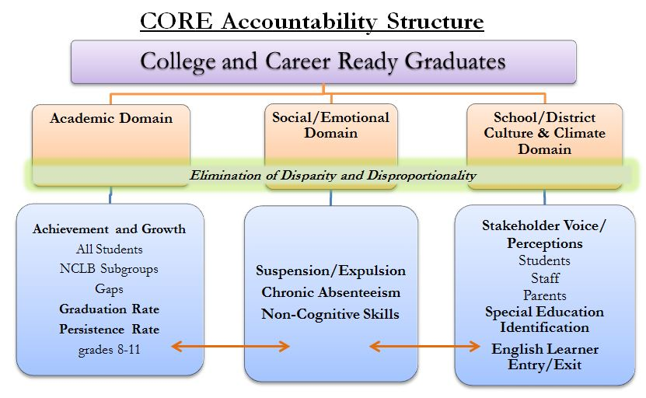

Slide 10
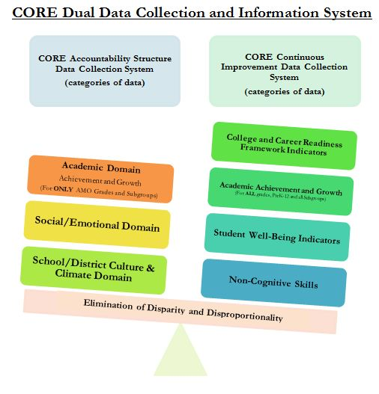

Slide 11
The CORE Waiver system provides for targeted interventions as opposed to one-size-fits-all requirements of NCLB Program Improvement
California
CORE Waiver
Nature of
Interventions
Interventions are the same for each school and LEA in a given year of Program Improvement
Required interventions are targeted based upon school needs (e.g., achievement gap, low grad rate)
Support
Available
System is one of top-down compliance and does not include cross-school/LEA collaborations
LEAs partner with peers to jointly work through implementation of initiatives (e.g., CCSS, teacher and principal evaluation system)
Lower-performing schools partner with exemplar school based upon area of focus
Evaluation
Schools and LEAs must progress though PI interventions without the flexibility to assess whether they are working well for their context
LEA and school partners hold each other accountable, partner to solve targeted problems together, and will notify CORE if peer falls out of good standing

Slide 12
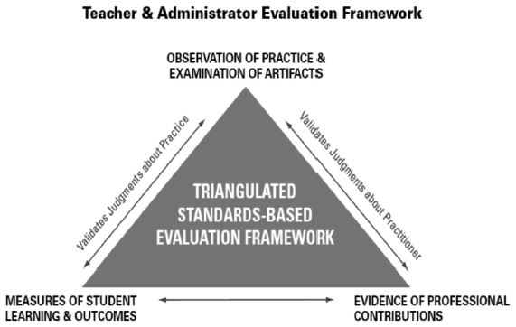
Adopted from Greatness by Design,
State Superintendent of Public Instruction Tom Torlakson’s Taskforce on Educator Excellence, September 2012

Slide 13
Teacher & Principal Evaluation and Support Systems
1
2
Student growth integrated through a “trigger” system
Student growth as a defined percentage
Similar to the Massachusetts model, misalignment between teacher/administrator professional practice and student performance will initiate dialogue between teachers and administrators to identify why a discrepancy between scores exists, followed by a 1 year improvement plan
Student growth will represent a minimum of 20% of teacher and principal evaluation calculations
Any negotiated lawsuit or court order will supersede the requirements for student growth per the CORE Waiver
CORE LEAs will choose will between both options in order to allow LEAs flexibility to maintain current systems that already meet USED requirements, while ensuring rigorous models and consistency across all participating districts

Slide 14
Nine CORE LEAs have signed on to the CORE Waiver; other LEAs will have the option to join onto the Waiver annually
CORE ESEA Waiver Participants
Timeline for Joining Waiver
This year, LEAs will have a short window over the summer to sign onto the CORE waiver
  We expect to hear back from USED around June 30th and expect LEAs will have until ~July 15th to participate
  Additional detail will be forthcoming depending on timeline from USED
  LEAs will need to have completed a thorough consultation with stakeholders prior to joining
An annual enrollment period will allow LEAs to join the CORE Waiver by April 15th of each subsequent year
Sacramento
Oakland
San Francisco
Fresno
Clovis
Sanger
Los Angeles
Long Beach
Santa Ana

Slide 15
How can CA Districts that are not in CORE participate in the Waiver?
Once the Waiver is approved, CA Districts may:
Officially request the following waivers from the US DOE (page 12 of the CORE ESEA Waiver Application*)
Agree to the US DoE assurances (page 13 of the CORE ESEA Waiver Application*)
Sign MOU with CORE (Appendix A. page 86 of the CORE ESEA Waiver Application*)
*CORE ESEA Waiver Application is located @ http://coredistricts.org/wp-content/uploads/2013/02/CORE-ESEA-Flexibility-Request.pdf

Slide 16
Questions?

